Slide 1
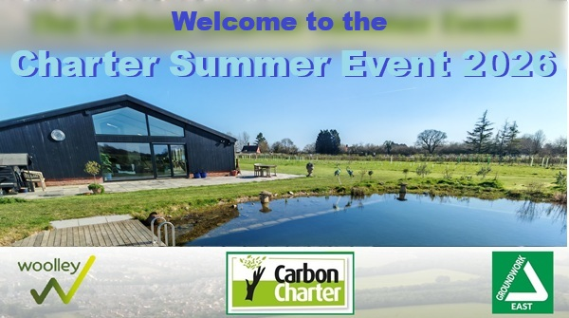

Notes:
Static holding picture as guests arrive and take their seats.

Slide 2





Peter Frost
Environment Strategy Officer, Suffolk County Council
Project Lead on the Carbon Charter Network
carboncharter.org
Notes:
Good afternoon everyone - Many thanks for attending – Just in case you don’t already know me, my name is Peter Frost and I am Environment Strategy Officer at Suffolk County Council. I am lead on the Carbon Charter project, helping businesses across Norfolk and Suffolk improve their environmental performance and reduce carbon emissions. Welcome to this amazing venue which continues a tradition of these Flagship events being a long way away from the usual, predictable and dry, business conferences. This year we mark another first in that, as far as we know, this is the first Networking Event of this kind powered by an electric car, which was charged up on Solar PV array, with vehicle to load capability feeding INTO the marquee. Where else could you be so close to the subject matter of the environment while finding out about how the future can be something to look forward to. Many thanks To Nick and Saffy for graciously opening their grounds to us today. I will be guiding today's event and providing an overview of the network's work to support businesses on their sustainability journey to support the transition to a low-carbon future.

Slide 3
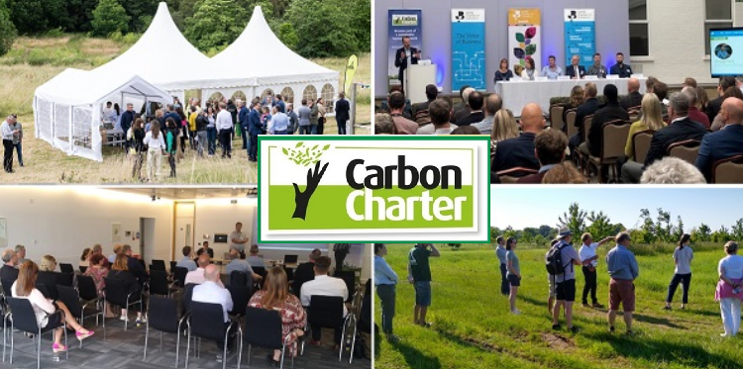
Notes:
The Carbon Charter has many networking events during the year with the Summer Event as the Flagship which offers something a bit different to the usual corporate conferences.

Slide 4
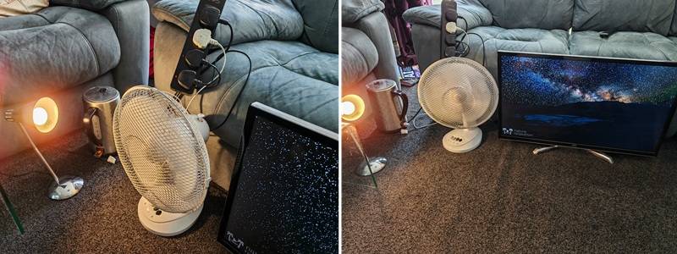
Welcome to yet another exclusive first from the Charter - Vehicle to Load (2 miles of range per hour of supply)
Notes:
Highly scientific laboratory testing (on my lounge floor) of household electrical items (a desktop fan, a lamp, a TV and a repeatably boiled kettle) powered from an electric car for an entire day… Prior to using Vehicle to Load capability to power the Charter Summer Event 2026 – As far as we know, the first event like this powered by this technology.

Slide 5
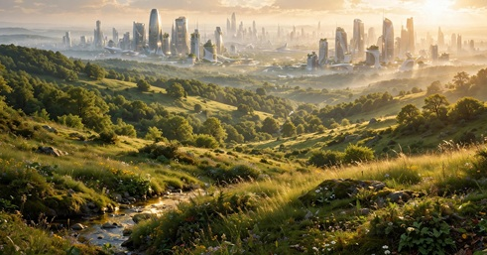


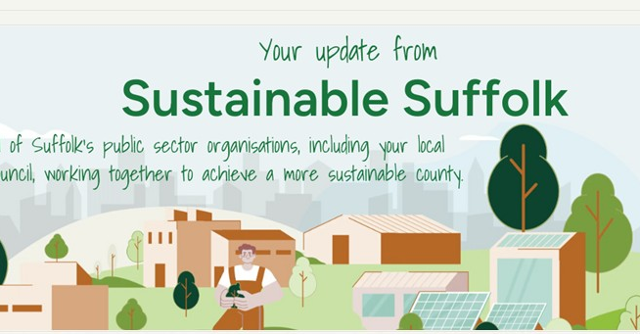
Just one aspect of the work Suffolk County Council
Is committed to delivering for a better future for everyone
Notes:
The Charter is a part of the overall Environmental Strategy at Suffolk County Council which has received acclaim across the UK – Team Suffolk leading the way – This is a County heavily dependent on the sustainability of our natural capital, whether it is for agriculture, tourism or just the better way of living that comes with looking after our world. Let’s all commit to making a better future for everyone (‘everyone’ is the trigger prompt for Claire to ‘spontaneously’ interrupt as we plug the Suffolk In Motion Event at Copdock near Ipswich on 10th October 2026)

Slide 6
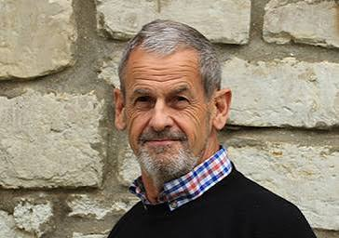
Intro Nick Woolley
Notes:
Nick Woolley is Founder of Woolley Property Management and the owner of Pilgrim’s Barn. This unique and beautifully restored venue showcases his strong commitment to sustainability and rural enterprise. We are grateful to Nick for his unwavering support for the Charter and for hosting today’s event.

Slide 7
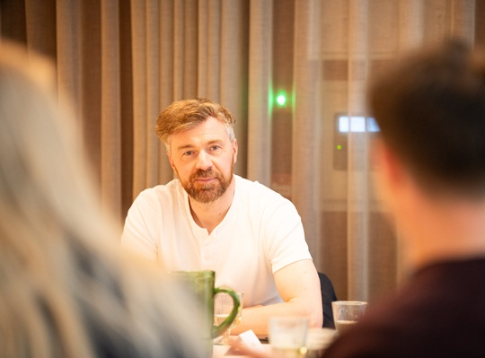
Intro Stuart McHendry
Notes:
Stuart McHendry played an instrumental role in the development of Pilgrim’s Barn, helping to bring the vision for this impressive venue to life. We are delighted that Stuart is joining us today to share his experience and the story behind the creation of this unique and sustainable building.

Slide 8
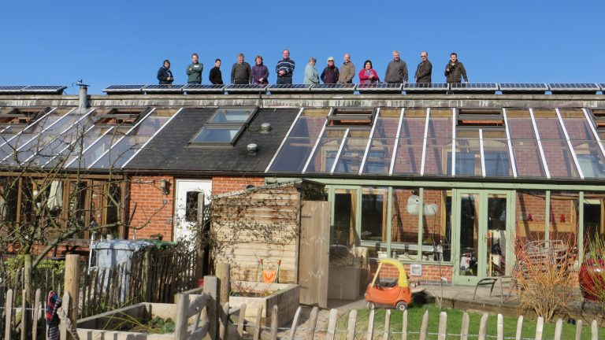

Special appearance by Simon Tilley
Notes:
As an added bonus, we’re delighted to welcome Simon Tilley, co-founder of the pioneering Hockerton Housing Project and a contributor to the design of Pilgrim’s Barn. His valuable insights into sustainable building design and low-energy living will give another fascinating perspective to the day.

Slide 9


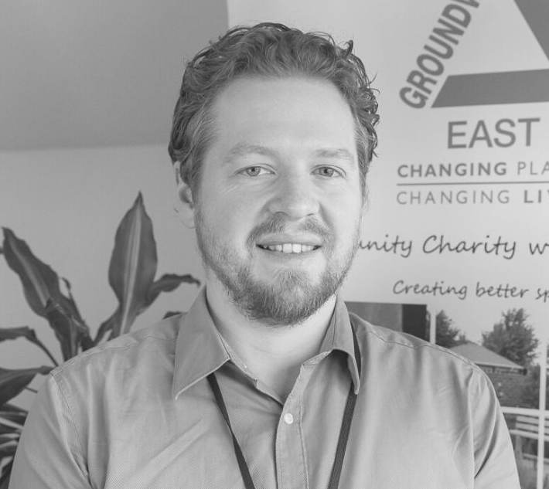
The Carbon Charter Award
Richard Jenner
Sustainability Consultant,
Groundwork East
Notes:
Richard Jenner is a Sustainability Consultant with Groundwork East, delivery partners for the Carbon Charter project. Richard will provide a brief update on the continued growth and success of the network, highlighting the positive impact it is having on businesses across the region.
Hello, my name’s Richard and I work for Groundwork East
For those of you who don’t know Groundwork East we are an environmental charity;
And we’re the delivery partner for the Carbon Charter, so we carry out the assessments, calculate the carbon footprints and deliver the training.

Slide 10



Independent environmental award scheme and sustainable business network
150 active members across Norfolk, Suffolk, and Essex
Gold, Silver, and Bronze awards. Carbon footprint reports, networking & training events.
Membership provides ongoing support from
Sustainable consultancy team
Delivered by Groundwork East
www.carboncharter.org
Notes:
So to start, Groundwork East jointly manages the Carbon Charter Award with Suffolk County Council. For those of you who are already members, thank you for being part of the network. For anyone who is new to the Carbon Charter, it is an independent environmental accreditation and sustainable business network that supports organisations on their journey to reduce emissions and improve sustainability.
As many of you are aware members achieve a Bronze, Silver or Gold award, depending on where they are in their sustainability journey. We currently have around 150 active members across Suffolk, Norfolk and Essex, all working towards a lower-carbon future.
As many of you will already know, membership is much more than receiving an award. Alongside your accreditation, you receive a carbon footprint report to help you measure, understand and monitor your emissions over time. You also gain access to regular networking events, training opportunities, and ongoing support from our sustainability consultancy team at Groundwork East. It's great to see so many familiar faces here today making the most of those benefits.
Membership to the award scheme lasts for 2 years, after which you can then renew if you wish to. Membership costs between £2,000 to £3,900, based on your business size, and don’t forget this is for 2 years, so there’s no other payment until you renew 2 years later.
Our aim is to support businesses throughout their clean growth journey, helping you become more resilient, reduce your environmental impact, and identify opportunities to save costs and improve efficiency. As a local charity, Groundwork East reinvests income from Carbon Charter memberships back into projects that benefit local communities and the environment, meaning your membership delivers positive impact beyond your own organisation.

Slide 11
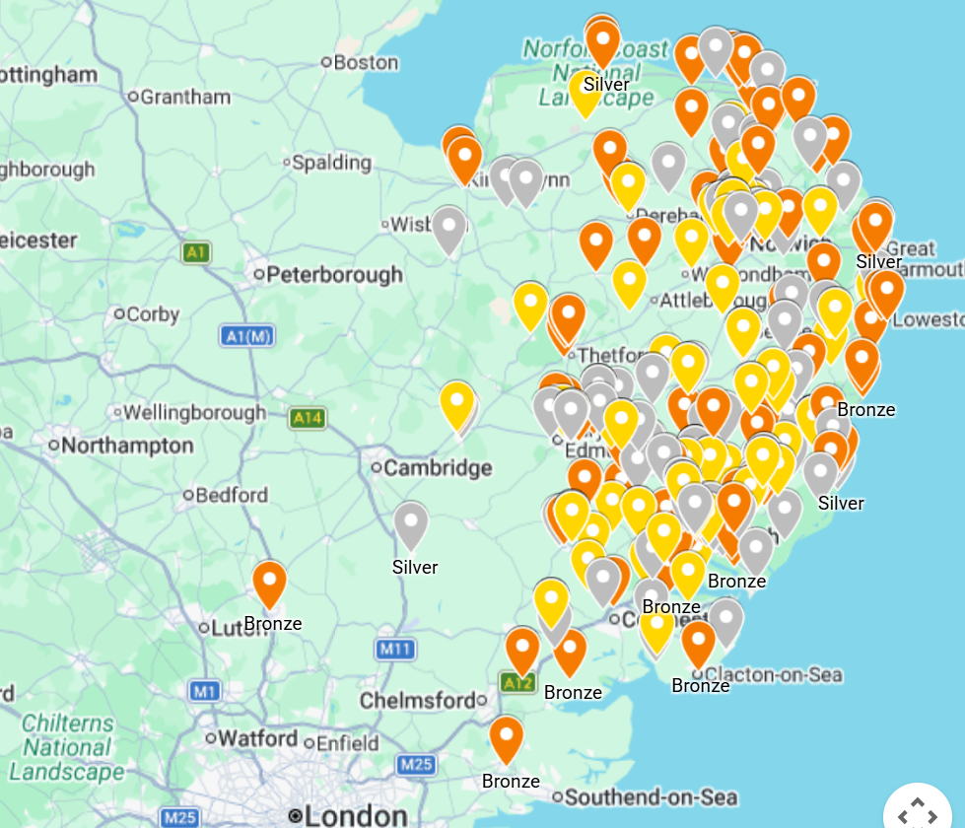



Notes:
This map shows the current Carbon Charter members across the region, with organisations achieving Bronze, Silver and Gold awards. It's always great to see how our network continues to grow and to recognise the progress that businesses are making on their sustainability journeys. I hope members in the audience can spot themselves on this map.
As many of you will know, the awards are independently assessed, ensuring that every accreditation reflects genuine progress and commitment.
The Bronze award provides the foundations for measuring and managing environmental impact. Members at this level have established key building blocks, including a carbon footprint, a Carbon Reduction Action Plan and an Environmental Policy.
The Silver award recognises organisations that have moved beyond planning into action. As well as meeting the Bronze requirements, members demonstrate measurable progress by achieving at least a 10% reduction in emissions over the previous two years.
Gold recognises organisations that are embedding sustainability throughout their business.
Alongside meeting the Bronze and Silver requirements, the independent panel looks for evidence of broader environmental leadership.
This might include:
Developing a comprehensive environmental or sustainability strategy.
Expanding carbon reporting to include more Scope 3 emissions. Implementing sustainable procurement practices and engaging suppliers to reduce their own emissions.
Sharing sustainability achievements with customers, staff and the wider community.
Supporting local environmental initiatives and volunteering.
Enhancing biodiversity on site or investing in nature-based projects.
There isn't a single checklist for achieving Gold; every organisation's journey is different. The panel looks at the overall commitment to continuous improvement and the positive environmental impact each member is making.

Slide 12

























Notes:
Here are just some of the organisations that make up our Carbon Charter community. I'm sure many of you will recognise yourselves or other businesses on here, and it's always nice to see the breadth of organisations involved.
What I really like about this network is the variety. We have manufacturers, tourism businesses, food and drink producers, engineering companies, professional services, charities and now even an NHS Trust, all working towards the same goal of reducing their environmental impact.
Although you're all at different stages of your sustainability journey, you're all part of a network that's helping to raise the standard across the region. Many of you are already leading by example, whether that's by reducing emissions, engaging your staff, improving biodiversity or sharing your experiences with other businesses.
It's also worth remembering that the landscape is changing. More customers and larger organisations are asking for evidence of environmental action, so maintaining your Carbon Charter award continues to demonstrate the progress you're making and the commitment you've already shown. Mention Sizewell C, NHS, central government and local authorities.
And of course, the membership isn't just about the award itself. It's about being part of this community, sharing ideas, learning from one another through events like today, and celebrating the fantastic work that's already happening across the network.

Slide 13
Benefits of the Carbon Charter
Detailed carbon footprint report & structured next steps (useful for tender submissions & funding applications)
Evaluation of Scope 3: water, climate risk, procurement, biodiversity
Members-only newsletters & ongoing support from the team
Website directory listing , networking events, discounted training
Communicate award to your stakeholders
Official Gold, Silver, or Bronze award logo & certificate
As a registered charity, we reinvest every penny back into the local community.
Join here: https://carboncharter.org/the-accreditation-process/
Notes:
Here are some of the benefits of the Carbon Charter, which has expanded following on our recent re-launch.
[Run through the benefits of the Charter. Also we offer member-only webinars, drop-in surgeries, etc.]

Slide 14
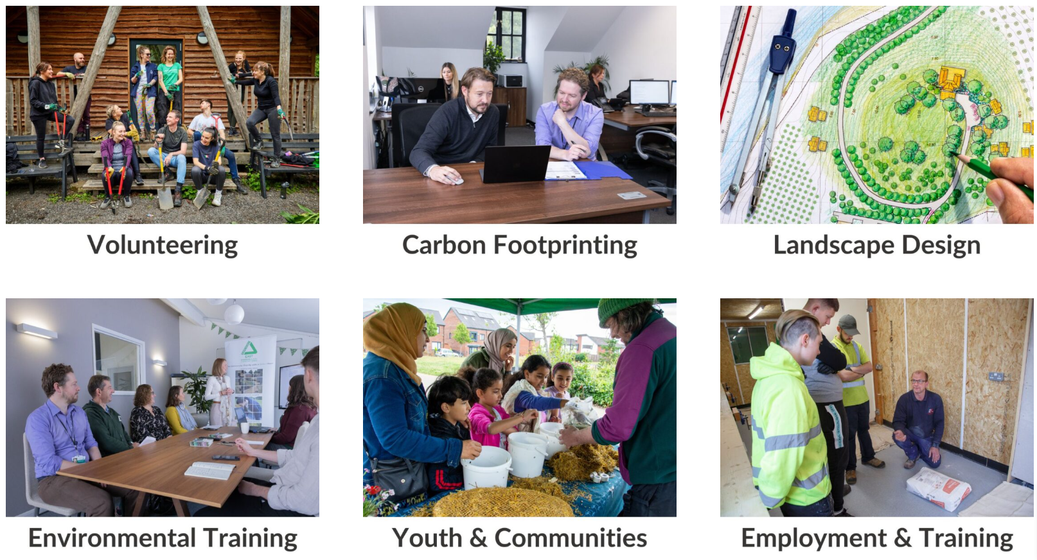
Other Sustainable Business Services
Groundwork Sustainable Business Services: groundworksbs.org.uk/
Environmental charity supporting businesses in the East of England
We offer:
Carbon footprint calculations
Decarbonisation plans
Support to access grant funding
Notes:
We also have a Sustainable Business Services team, who can assist you with any in-depth requirements you may have on your journey to ‘clean growth’.
The Sustainable Business Services team at Groundwork East offers other paid services to help SMEs, including carbon footprint expertise and decarbonisation plans.
We can also provide guidance on available funding options, which can include new heating systems, insulation upgrades, windows, solar PV, etc.
These types of upgrades are likely to save you money by reducing the amount of energy you need to use.

Slide 15

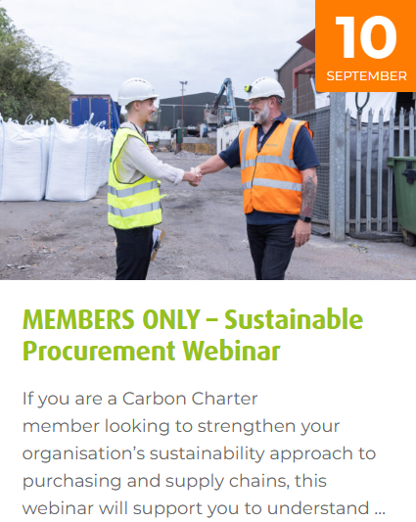
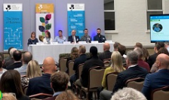
Richard Jenner
Sustainability Consultant,
Groundwork East
richard.jenner@groundwork.org.uk
info@carboncharter.org
Upcoming webinars/events: www.carboncharter.org/events
Notes:
Just in case you don’t know these are our contact details.
For members, we will have a sustainable procurement webinar on 10th September and our members only drop-in surgery on the 15th October.
You can always approach me later for questions etc.

Slide 16
Congratulations to newly accredited Charter Members
30th July 2026 Pilgrim’s Barn, Woolley
Notes:
Ten awards to hand out today – The biggest number at a Summer Event and a sign of how the Charter is growing. (Plus ‘special’ surprises along the way).

Slide 17
FOOD AND NETWORKING
Please enjoy delicious food from Allison’s Eatery of Bury St Edmunds and take a look around this amazing venue
Many thanks for attending…
Notes:
Many thanks for attending - Static holding picture as guests leave their seats and explore around the Pilgrim’s Barn gardens and pools, look around the Electric cars and robot lawnmowers on display and get a chance to eat and chat in the enjoyably informal atmosphere of the event.

