Slide 1
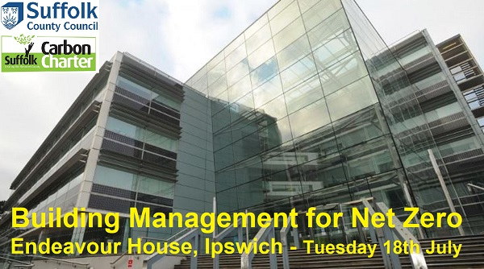
WELCOME

Slide 2

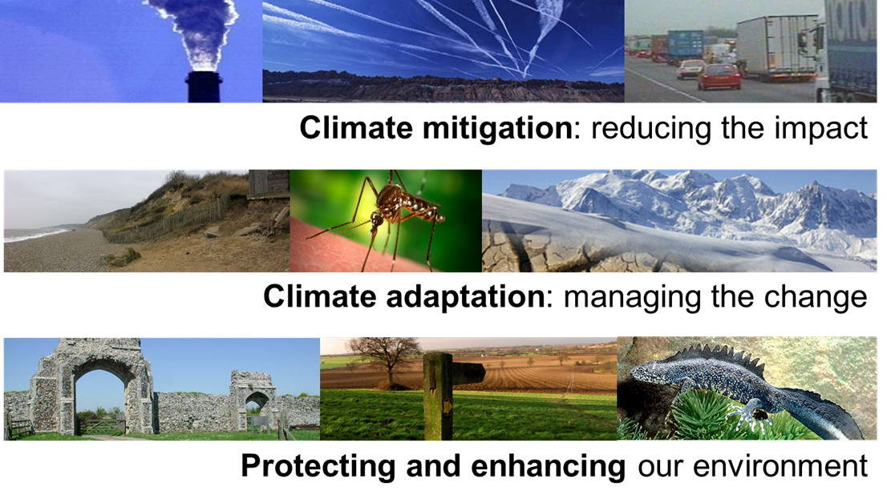

Carbon Negative
Net zero carbon emissions for SCC operations by 2030
Deliver reputational and financial benefits to SCC by successfully managing the risks and opportunities climate change presents.
Work with organisations and communities to aim for a net zero Suffolk at the earliest opportunity (Suffolk Climate Emergency Plan)
www.suffolk.gov.uk/planning-waste-and-environment/initiatives/our-climate-emergency-declaration

Slide 3
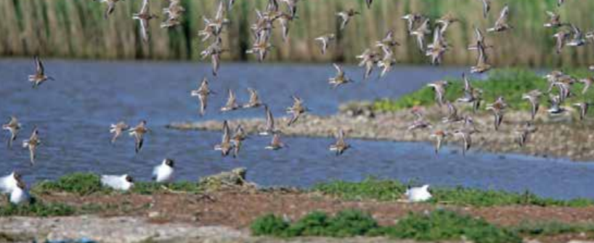
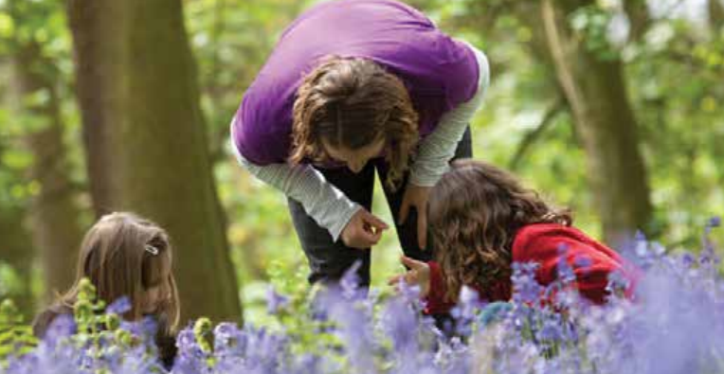
Nature Positive
Suffolk County Council will:
Positively enhance the biodiversity value of at least 30% of its land and assets by 2030
Work with partners, businesses, landowners and communities towards achieving a similar goal for Suffolk as a whole
Define a baseline of the Council’s land and assets against which to measure progress towards this objective is defined by 2023 at the latest.
https://committeeminutes.suffolk.gov.uk/DocSetPage.aspx?MeetingTitle=(01-02-2022),%20The%20Cabinet

Slide 4

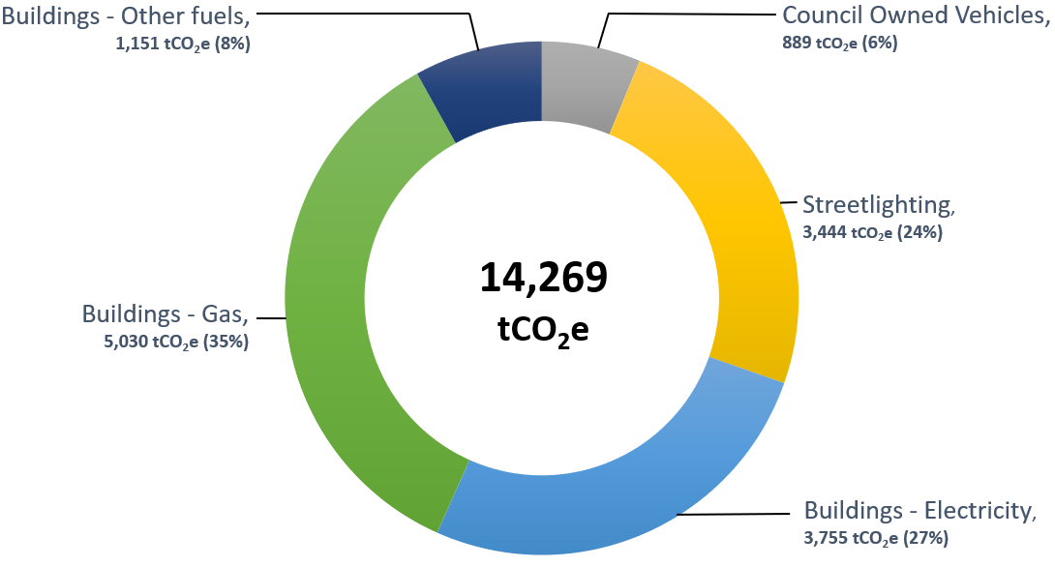
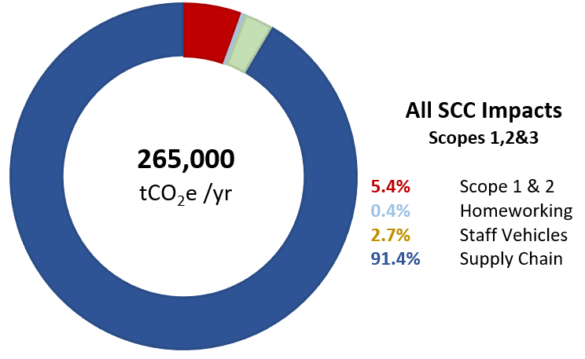

Direct & Indirect Impacts
Notes:
Scope 1 – gas & fuels
Scope 2 – electricity
Scope 3 – everything else

Slide 5
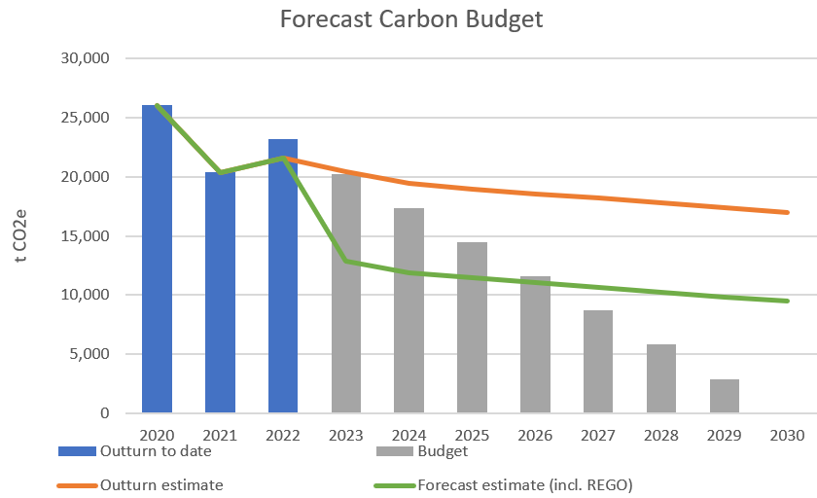

Progress towards target
Health Warning:
Reported SCC emissions will rise as we develop methods of measuring the true carbon cost of everything we do.
Exclusions:
Most of Scope 3 not captured within the current iteration of the Carbon Budget

Slide 6


Our Buildings
9,936 tCO₂e
46% since 2019/20
£12.8m decarbonisation budget of which £0.4m spent
Avoided costs of £0.90/ per £1 spent
Since 2021, 62% reduction in gas use across largest 6 buildings – 36% reduction in total footprint
  Doubled Solar panel installations
  Use of AMR data monitoring & BMS controls to reduce waste
  Micro Louvres to reduce solar gain
  Destratification fans to circulate heat
  Upgraded streetlighting
  Flexible working

Slide 7



Our Travel
8,170 tCO₂e
18% since 2019/20
Pool car fleet 40% electric
Transitioning rest of Fleet
EV Charge points
Revised Travel Plan
Flexible Working
What We Buy
240,000 tCO₂e
Not able to track changes (yet)
Climate Change Commercial Ask
Targeting top 100 (61% of spend) & Top 1000 (95% of spend)
Procurement training
Highways Contract
Carbon Charter support

Slide 8
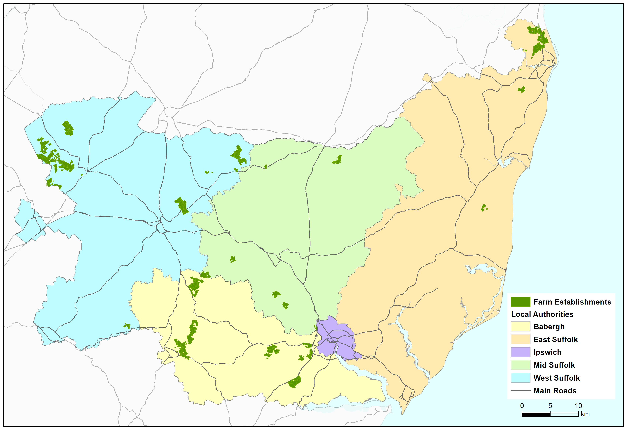

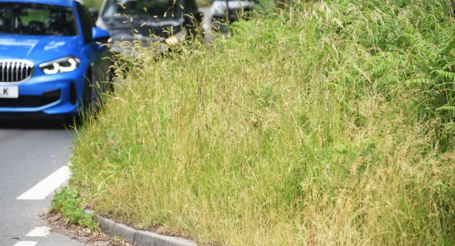


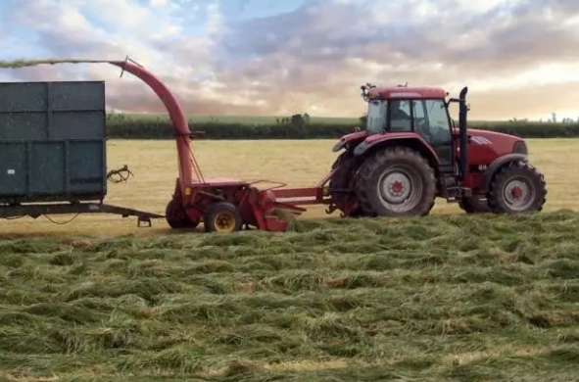

Nature Positive
  Baselining Biodiversity
  County farm estate + 50% of schools + highways. Mix of land use change and altered practice
  Highways Contract
  Environment ambitions embedded through the procurement process
  Nature Recovery
  Continued joint work with Norfolk CC on local nature recovery and developing nature-based solutions. Local Nature Recovery Strategy
County Farms
UEA report on Natural Capital potential of County Farms. Revising tenancy criteria & tenancy engagement

Slide 9








SCEP - Highlights so far
20 projects supported by SPSL funding
300+ businesses supported by the Net Zero Business Advisor Service
120,000 visitors to the Green Suffolk Website since the publication of the SCEP
11 communities supported by the Climate Emergency Community Match Fund
191.58 tonnes of CO₂ savings identified by the VCSO Audit Service
100 homes
supported with the Homeowners Support Service
Over £28mn in external funding drawn down

Slide 10


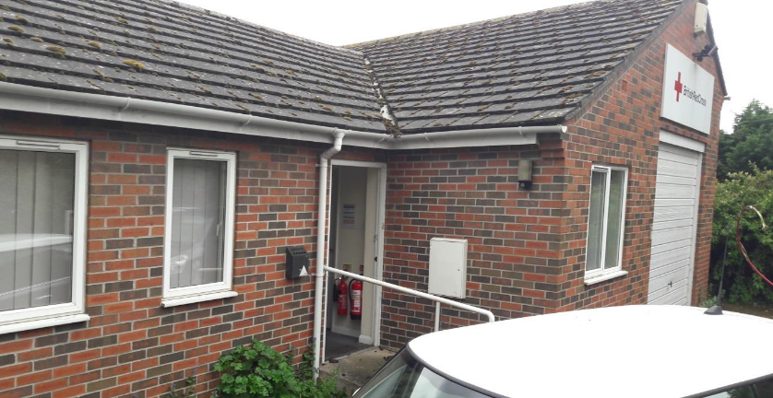

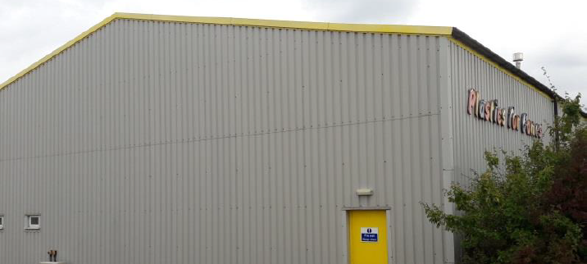

Health clinic. Cut footprint by 43% with Heat Pump, Insulation & LEDs.
Warehouse based wholesaler. Reduced carbon footprint by 48% through lighting upgrades and other measures.
Office based telecommunications firm. Solar array has cut their carbon footprint by 22%.
carboncharter.org/make-the-25-by-25-pledge/

Slide 11
The Roadmap to Net Zero
Decarbonising Suffolk county council’s CORPORATE ESTATE

Slide 12


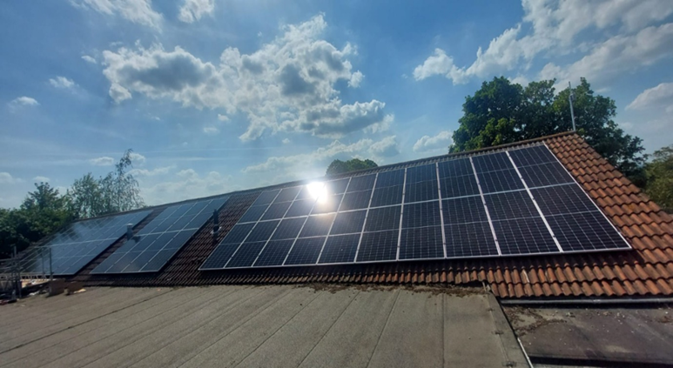



Background
Net Zero Carbon Emissions
“Achieving a balance between the carbon emitted into the atmosphere, and the carbon removed from it”.
Key Themes of the Programmme:
Invest to Save – Reduce running costs
Maximising Self Generation Opportunities (Including Battery Storage)
Publication of Yearly Carbon Budget
Transition Fleet to EV by 2025
Fuel mix must consider not only environmental sustainability but cost and availability
(Over half of the UK’s Electricity is still reliant on gas for generation. Upgrading electricity infrastructure is expensive and requires long lead times.)

Slide 13
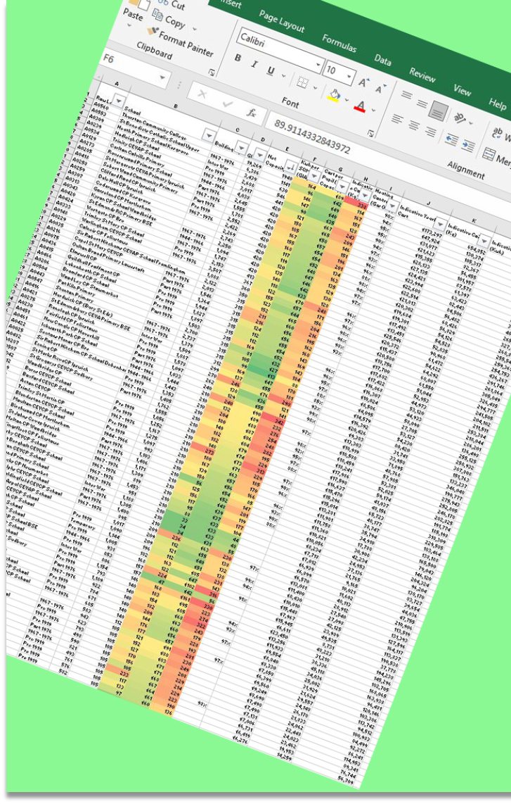
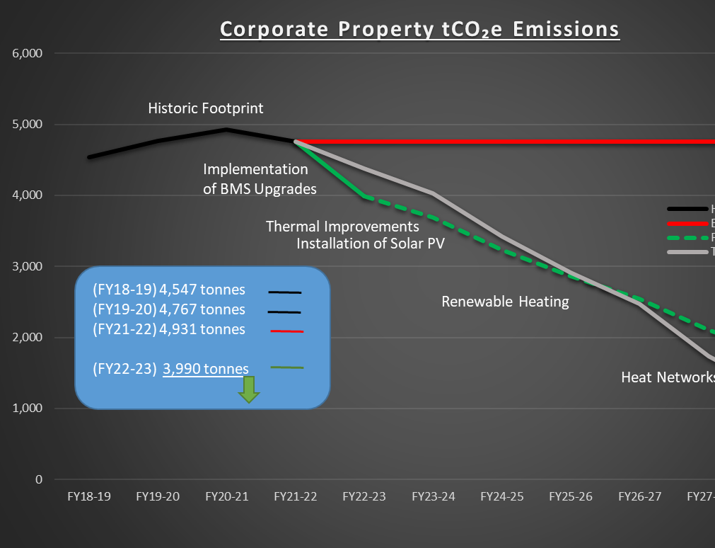
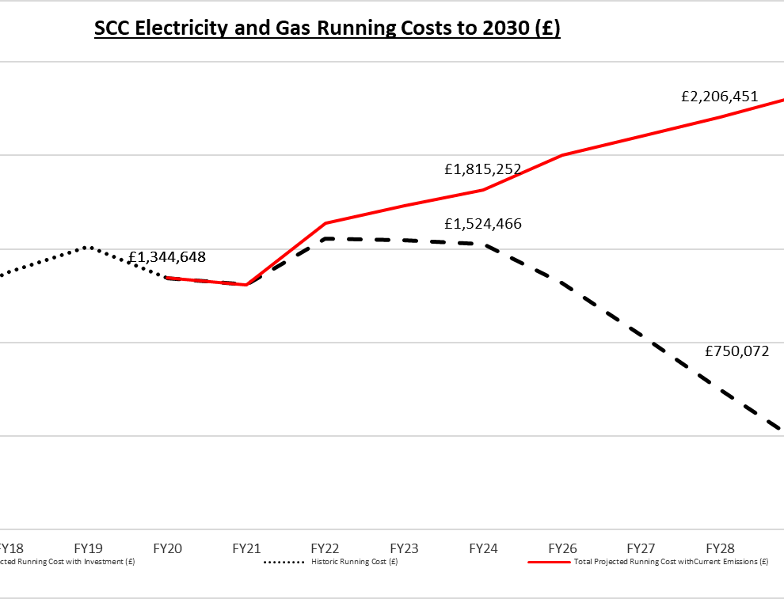
The Data Led Phased Approach
5 Year Energy and Cost Review of all Sites and all Fuels to establish usage trends, seasonal patterns and onward projections.
Map out the route to reducing energy, how much it will cost and how much it will save.
Current market and regulatory conditions have dictated an agile methodology – Be prepared to reassess.

Slide 14
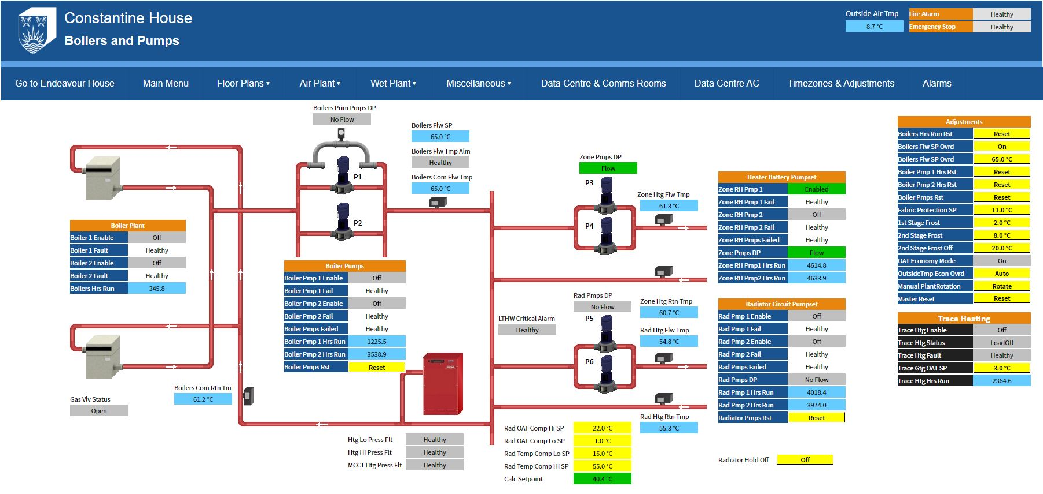
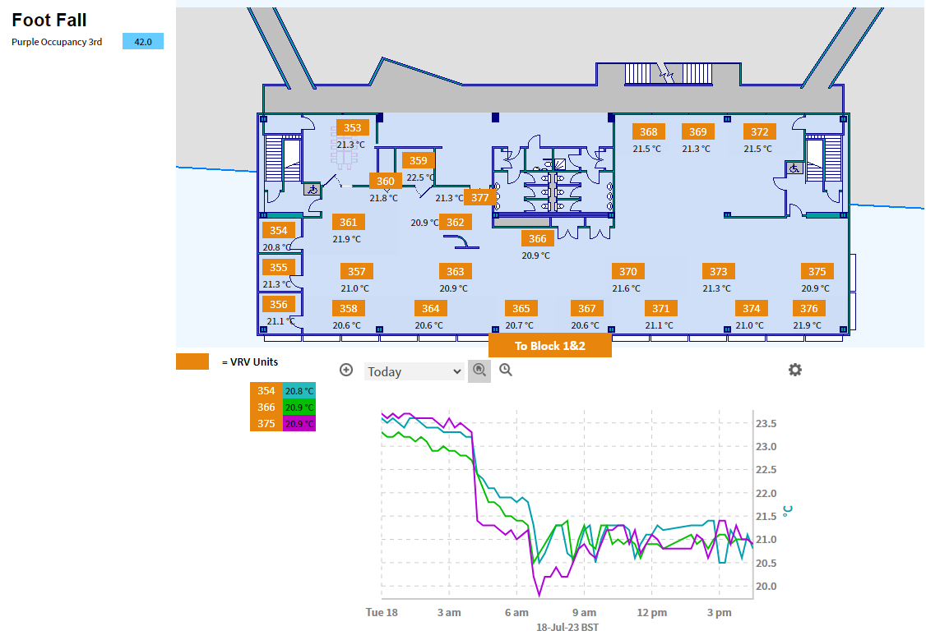
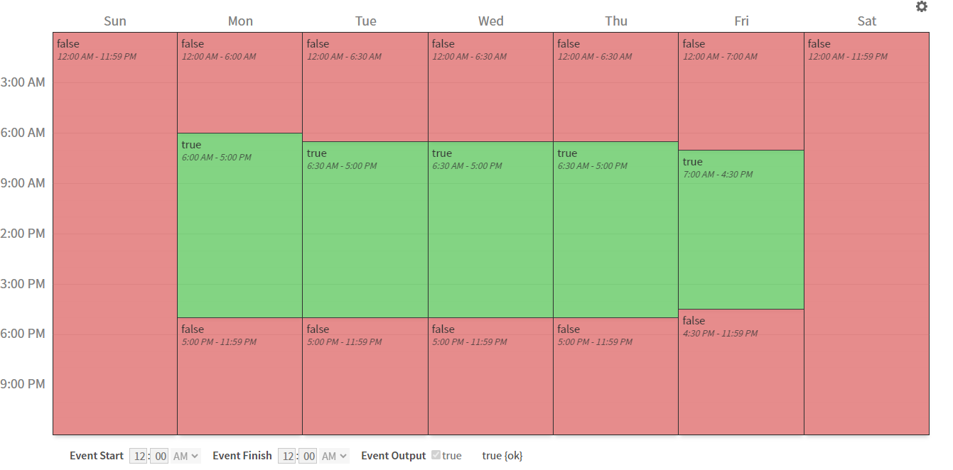
BMS System Upgrade
Improved Energy Control
Optimal Time Schedules
Set Point Control
Air Recirculation
Footfall Monitoring
Automation

Slide 15
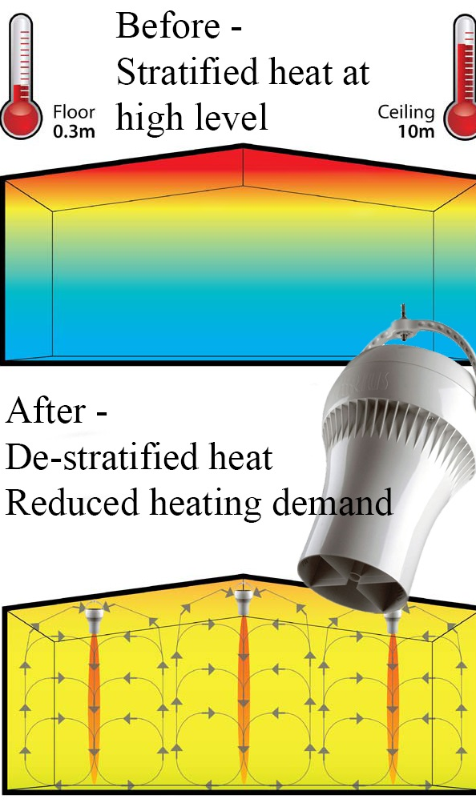

Intelligent Intervention
Where are you too much energy?
A solution designed to fit the problem.
De Stratification Fans
Micro Louvres

Slide 16







Communication
An important part of any energy management programme is to embed the process structure within the organisation’s everyday processes.
Supply chain and Contractors
Awareness of Programme Activity and Potential Shift in Focus.
Expectation of Behaviours and Contributions.
Shared Experiences
Building Users, Staff and Interested Parties
Engagement and Shared Ownership.
Inclusion – Opportunity to Contribute Ideas.
Shared Experiences

Slide 17
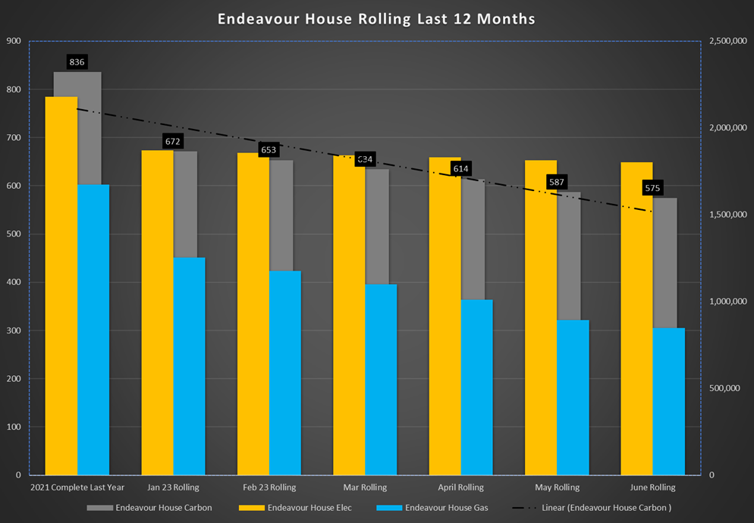
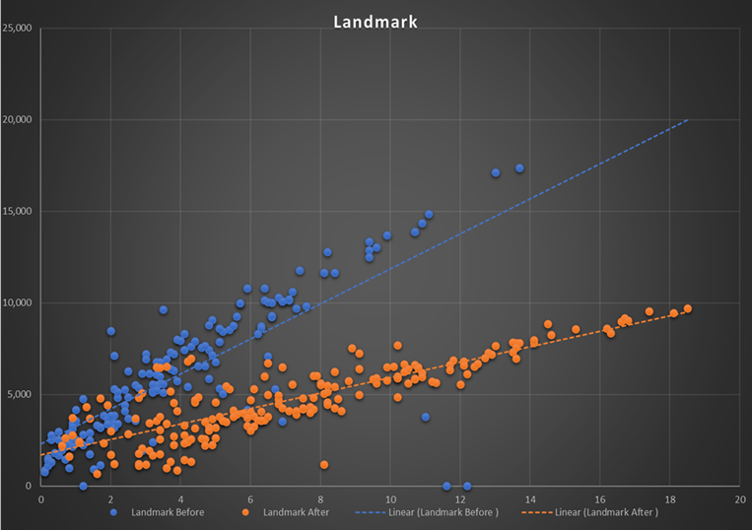
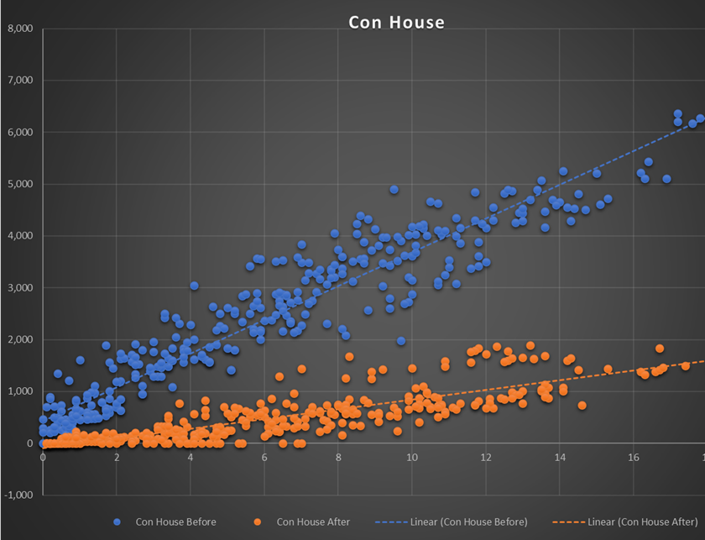
Verification of Results
BMS Improvements Implemented Dec 2021
The council has reduced the carbon footprint from utilities of it’s Top 6 buildings by over 35% including:
62% reduction in gas usage
12% reduction in electricity usage.
To the left are some graphical representations of the difference.

Slide 18
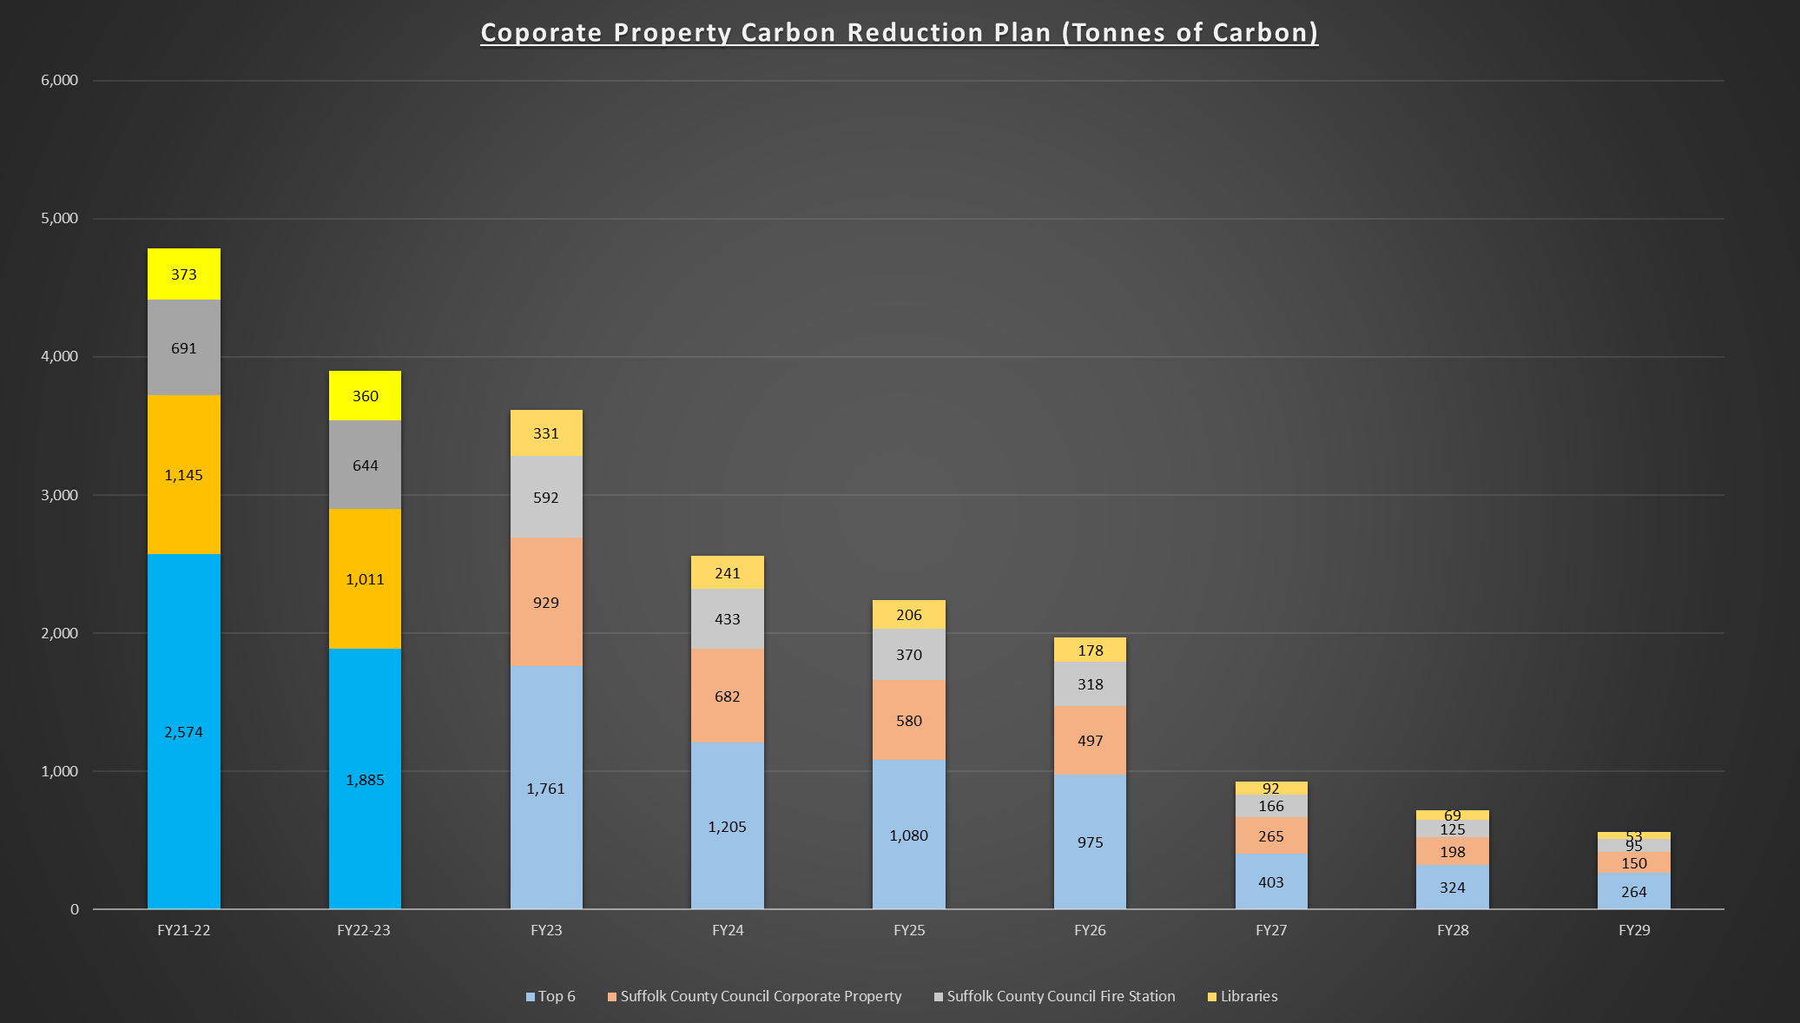
The Road Map

Slide 19
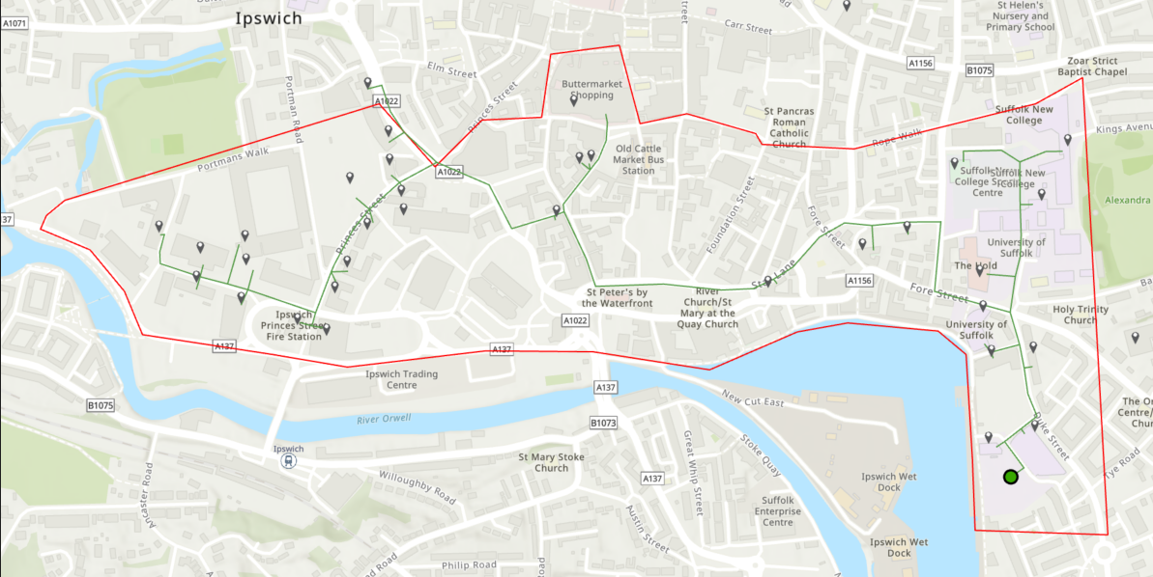
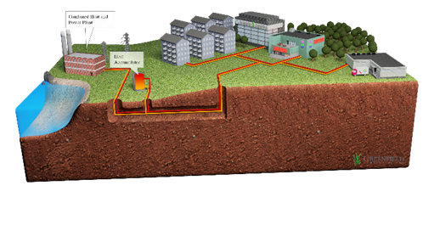
A Heat Network for Ipswich
A Connected Concept
Part HNDU Funded Feasibility
Results of initial Feasibility Received

Slide 20
Questions?

Slide 21
Many thanks for your attendance
Find out more about the CARBON CHARTER at www.carboncharter.org

