Slide 1
Air Quality and Your Business
Clean Air Day Webinar, 16th June

Slide 2



Air Pollution is a Public Health Emergency
40,000
£2.7 billion
Deaths a year linked to air pollution in the UK
The cost of air pollution to the UK economy
(Royal College of Physicians, 2016)
(DEFRA, 2012)
Notes:
Financial impact due to NHS and days off work

Slide 3





Reducing common air pollutants will improve your employee’s health and reduce sick leave…
Pollutants:
Nitrogen dioxide
Particulate matter
Volatile organic compounds
Carbon monoxide
Ozone
Health Impact:
Short-term:
Reduced concentration
Headaches
Coughs
Skin conditions
Allergens
Long-term:
Respiratory and cardiovascular disease
Cancer
Dementia
Diabetes
Notes:
The impact of IAQ on an individual depends on the following factors:
The susceptibility of the individual (susceptibility is higher in those with pre-existing diseases such as asthma, Chronic Obstructive Pulmonary Disease (COPD), and cystic fibrosis, and those who are pregnant or older)
Concentration of the pollutant when the person is exposed
Continuous or intermittent pollutant
Duration of exposure
Exposure to multiple pollutants may increase the impact.

Slide 4
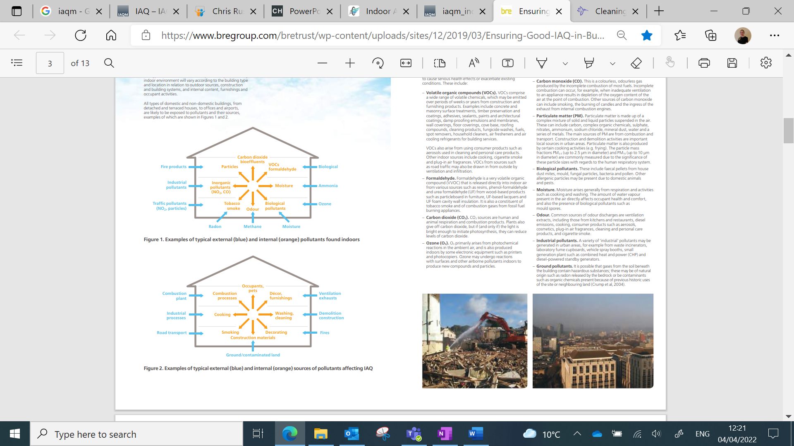
Pollutants and Sources
Notes:
Outside and inside

Slide 5
Pollutants and Sources
Notes:
Outside and inside

Slide 6
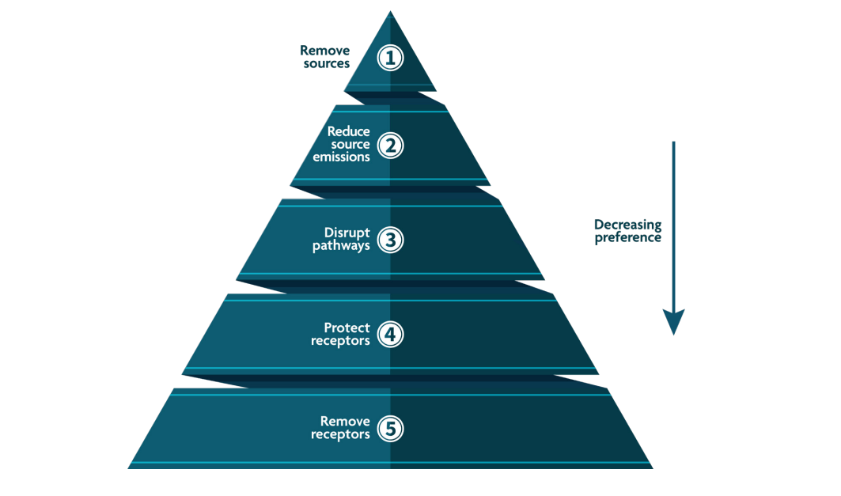
Hierarchy for Improving AQ
Improving AQ should be considered through the hierarchy of improvement measures:
Source: Institute of Air Quality Management, 2021. Indoor Air Quality Guidance: Assessment, Monitoring, Modelling and Mitigation
Notes:
Cleaning products
Paint
Heating systems
Maintaining vehicles
Ventilation/absorbing pollution
Vehicles EVs

Slide 7
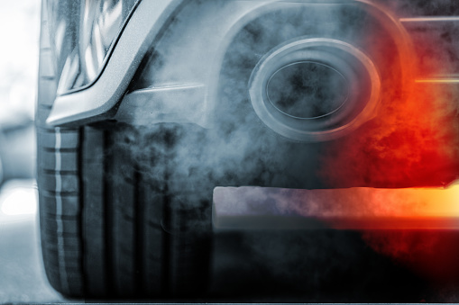
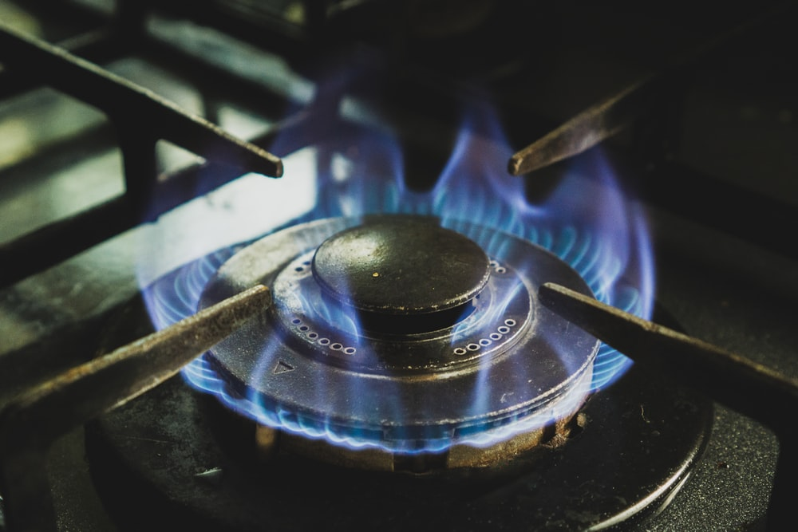
Nitrogen Dioxide
Notes:
Produced in the combustion of fuels such as gas and diesel, from vehicles, industry, and heating.
Indoors gas-fuelled cookers, and poorly flued (or unflued) fires, water heaters and space heaters.

Slide 8
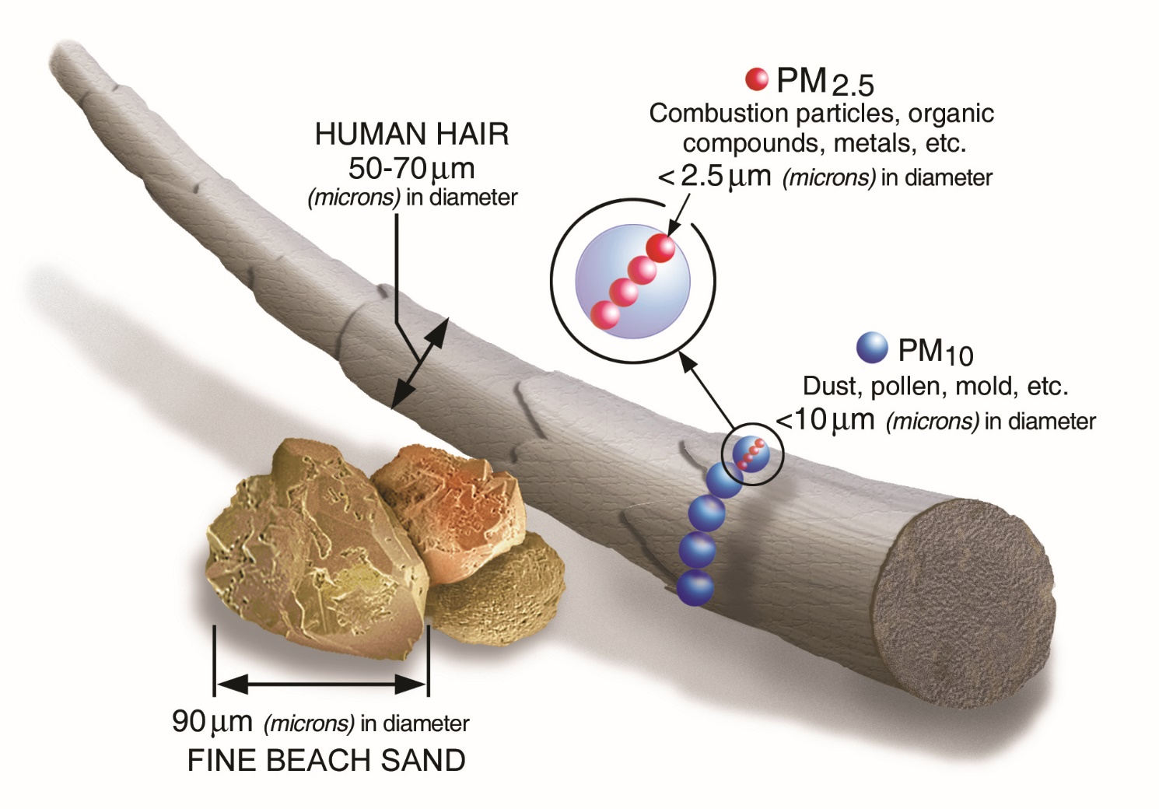
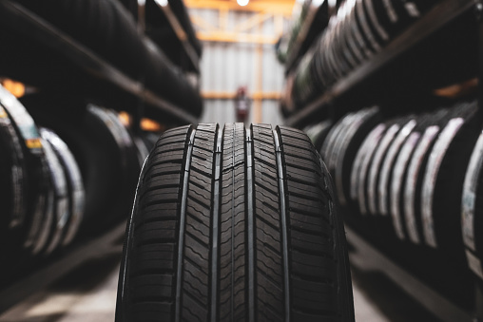

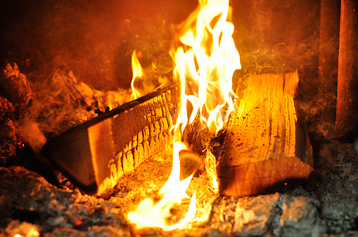


Particulate Matter
Notes:
PM is a complex mixture of solid and liquid particles suspended in the air.
External:
Combustion of diesel
Brake and tyre wear
Construction and demolition
Saharan dust
Internal:
Renovation works
Cooking (particularly frying)
Smoking
Wood burning fires/stoves (Woodsure | the UK's only woodfuel certification scheme |)
Burning candles
Clothing, carpets, and soft furnishings also release particles/fibres into the air

Slide 9
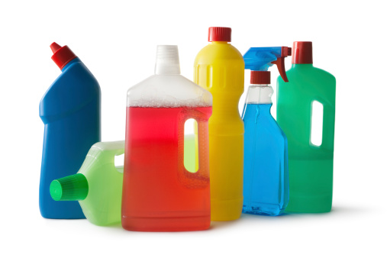
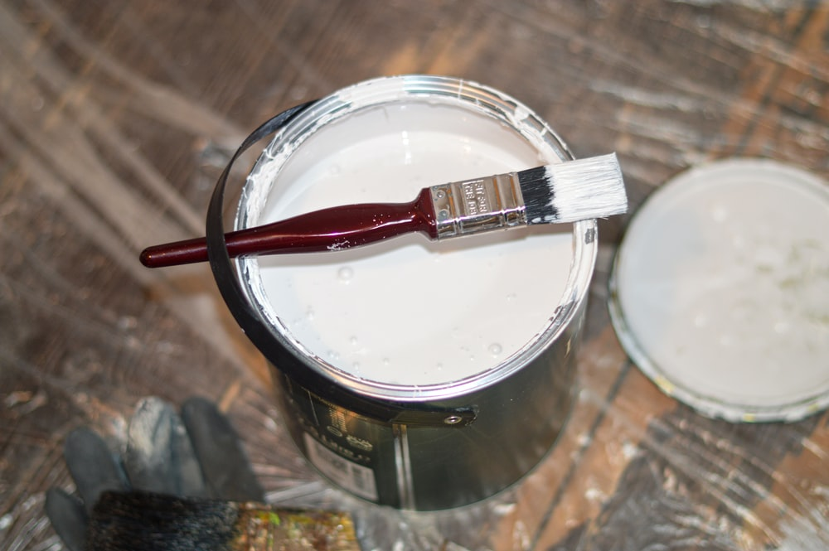
Volatile Organic Compounds (VOCs)
VOCs comprise a wide range of volatile chemicals, which may be emitted over periods of weeks or years from construction and furnishing products.
Notes:
Concrete and masonry surface treatments
Timber preservation and coatings
Adhesives
Sealants
Paints
Architectural coatings
Damp proofing emulsions and membranes
Wall coverings
Floor coverings
Cove base
Roofing compounds
Cleaning products
Fungicide washes
Fuels
Spot removers
Air fresheners
Air-cooling refrigerants
Aerosols used in cleaning and personal care products
Cooking
Cigarette smoke
Plug-in air fragrances
VOCs from sources such as road traffic may also be drawn in from outside by ventilation and infiltration.

Slide 10
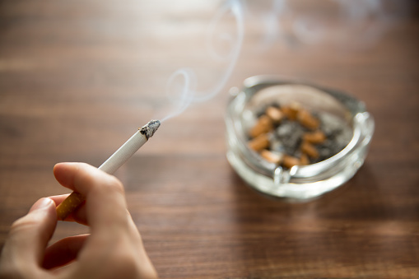
Carbon Monoxide (CO)
Notes:
CO is emitted during inefficient combustion processes.
High concentrations indoors are typically due to the use of incorrectly installed, poorly maintained, or poorly ventilated gas heaters and cookers.
Smoking
Burning candles

Slide 11

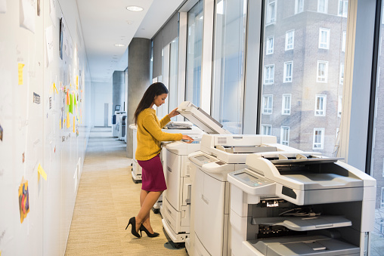
Ozone
Notes:
Electronic equipment such as printers
Some air cleaning appliances
External – the breakdown of nitrogen dioxide

Slide 12
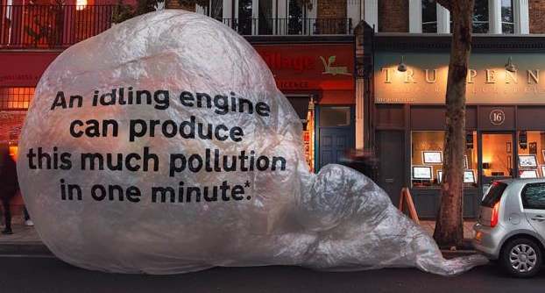
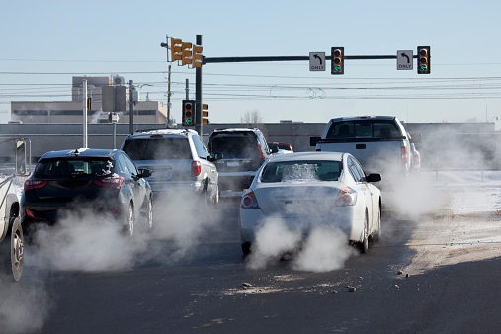
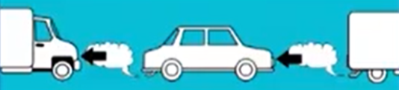
Vehicle Idling
Idling = leaving your vehicle’s engine running whilst stationary
Notes:
EVs first but if not…
When a vehicle is idling the pollution is not dispersed. It builds up around the vehicle.
Idling is unnecessary, wasteful and a nuisance (residents complaints).
Roadside idling is against the law (Road Traffic (Vehicle Emissions) (Fixed Penalty) Regulations 2003)
Idling produces enough exhaust emissions to fill 150 balloons a minute. Idling tends to happen in busy areas, think about the effect of your emissions on people nearby.
Pollution can be higher inside a vehicle, in traffic switch air to recirculate.
Cut the engine when you need to take a break and upgrade vehicles where possible (older models and diesel are worst).

Slide 13
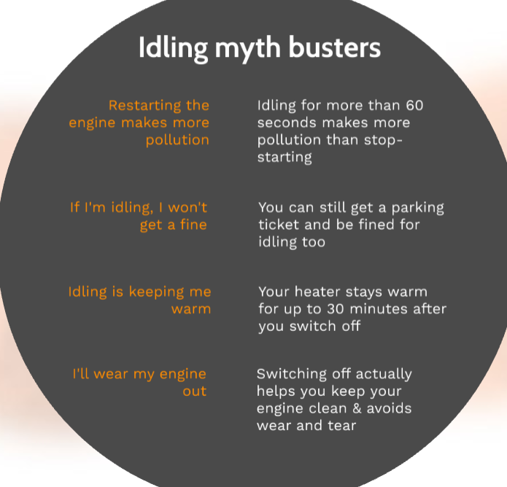

Slide 14
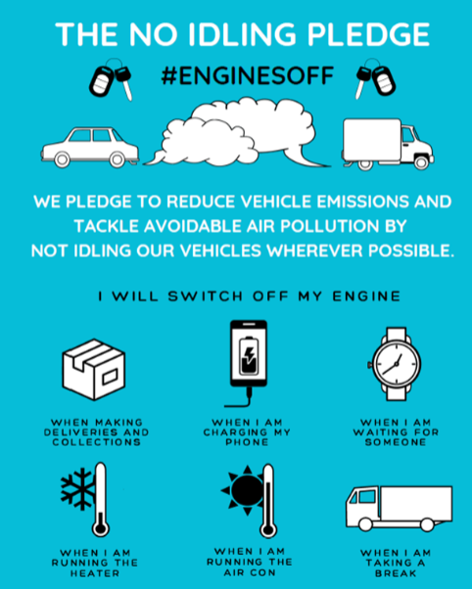
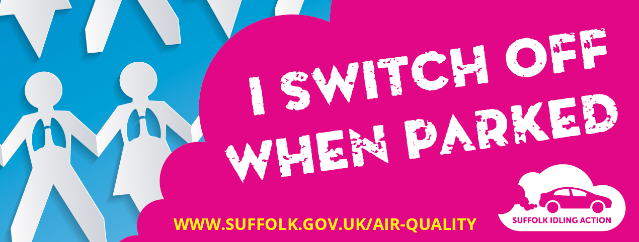
#enginesoff materials reproduced with the kind permission of the Mayor of London
Notes:
Commit to clean air
Switch off when safe to do so
NO2 monitoring – worst air pollution and AQMAs in Suffolk are all areas of idling traffic

Slide 15



Commuting and Active Travel
122 MtCO2e
34% NOx
15%
42%
Notes:
How do your employees travel to work? Commuting is a huge source of pollution
In 2019, domestic transport was responsible for emitting 122 Million tonnes CO2e. In 2018, 34% of Nitrogen Oxides (NOX) emissions and 13% of Particulate Matter (PM2.5) emissions came from transport. (DfT, Transport and Environment Statistics 2021 Annual report)
Research by MobilityWays found that 42% of commuters could walk or cycle, but only 15% do, and 46% could use public transport but only 18% do.
Why not conduct a survey to find out how your employees travel to work?

Slide 16
Active Travel Actions
Provide information on travel options
Bike maintenance sessions
Provide bike storage
Provide lockers and showers for cyclists
Promote walk to work week or car free day
Promote clean air walking routes
Run a pedometer challenge

Slide 17

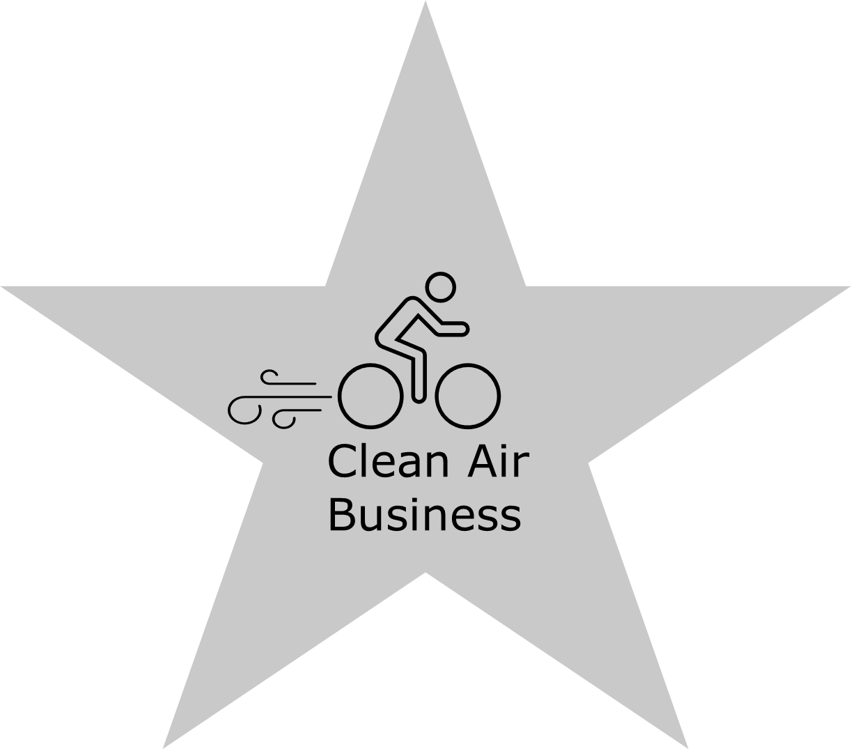

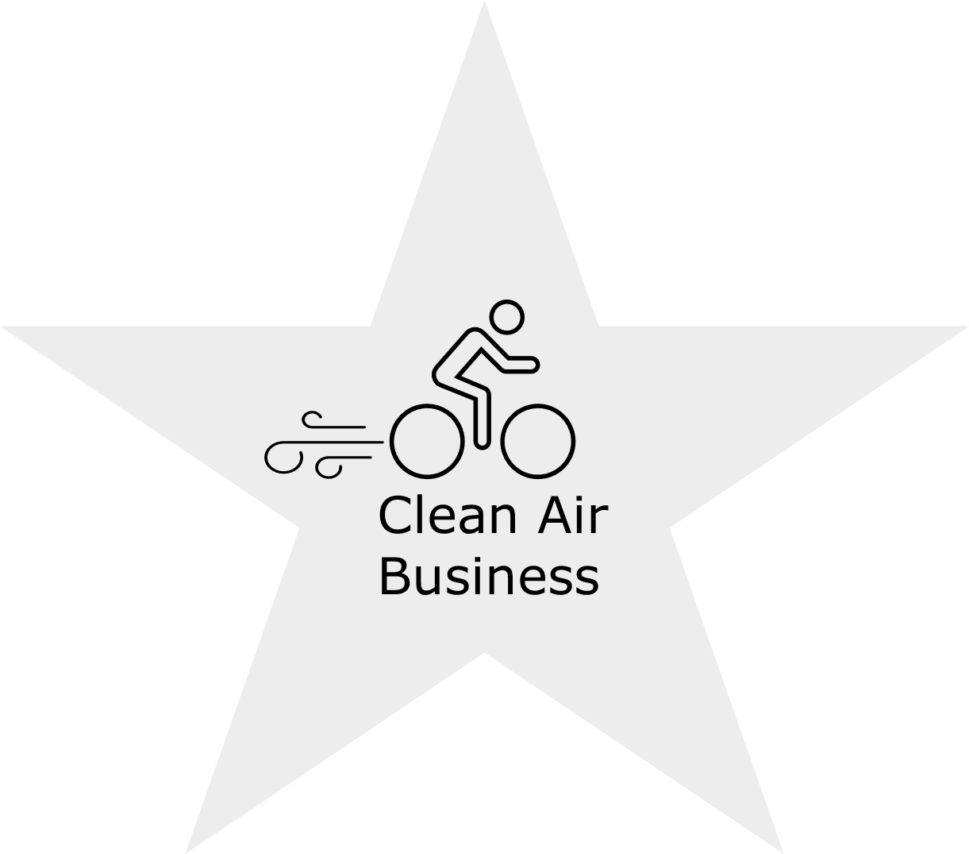
The Clean Air Business Scheme
Choose from:
  14 AQ initiatives
  76 travel initiatives
  29 supporting initiatives
Notes:
Supporting initiatives are policies and monitoring of staff travel and success of actions
Bronze:
Complete a staff travel survey
Deliver 5 sustainable travel initiatives
Deliver 2 supporting initiatives
AQ: Deliver 3 AQ actions

Slide 18
To sign up for Clean Air Businesses in West Suffolk or for active travel support in Suffolk: thewaytogosuffolk@suffolk.gov.uk
For any air quality questions:
elysia.scully@westsuffolk.gov.uk

