Slide 1



Slide 2
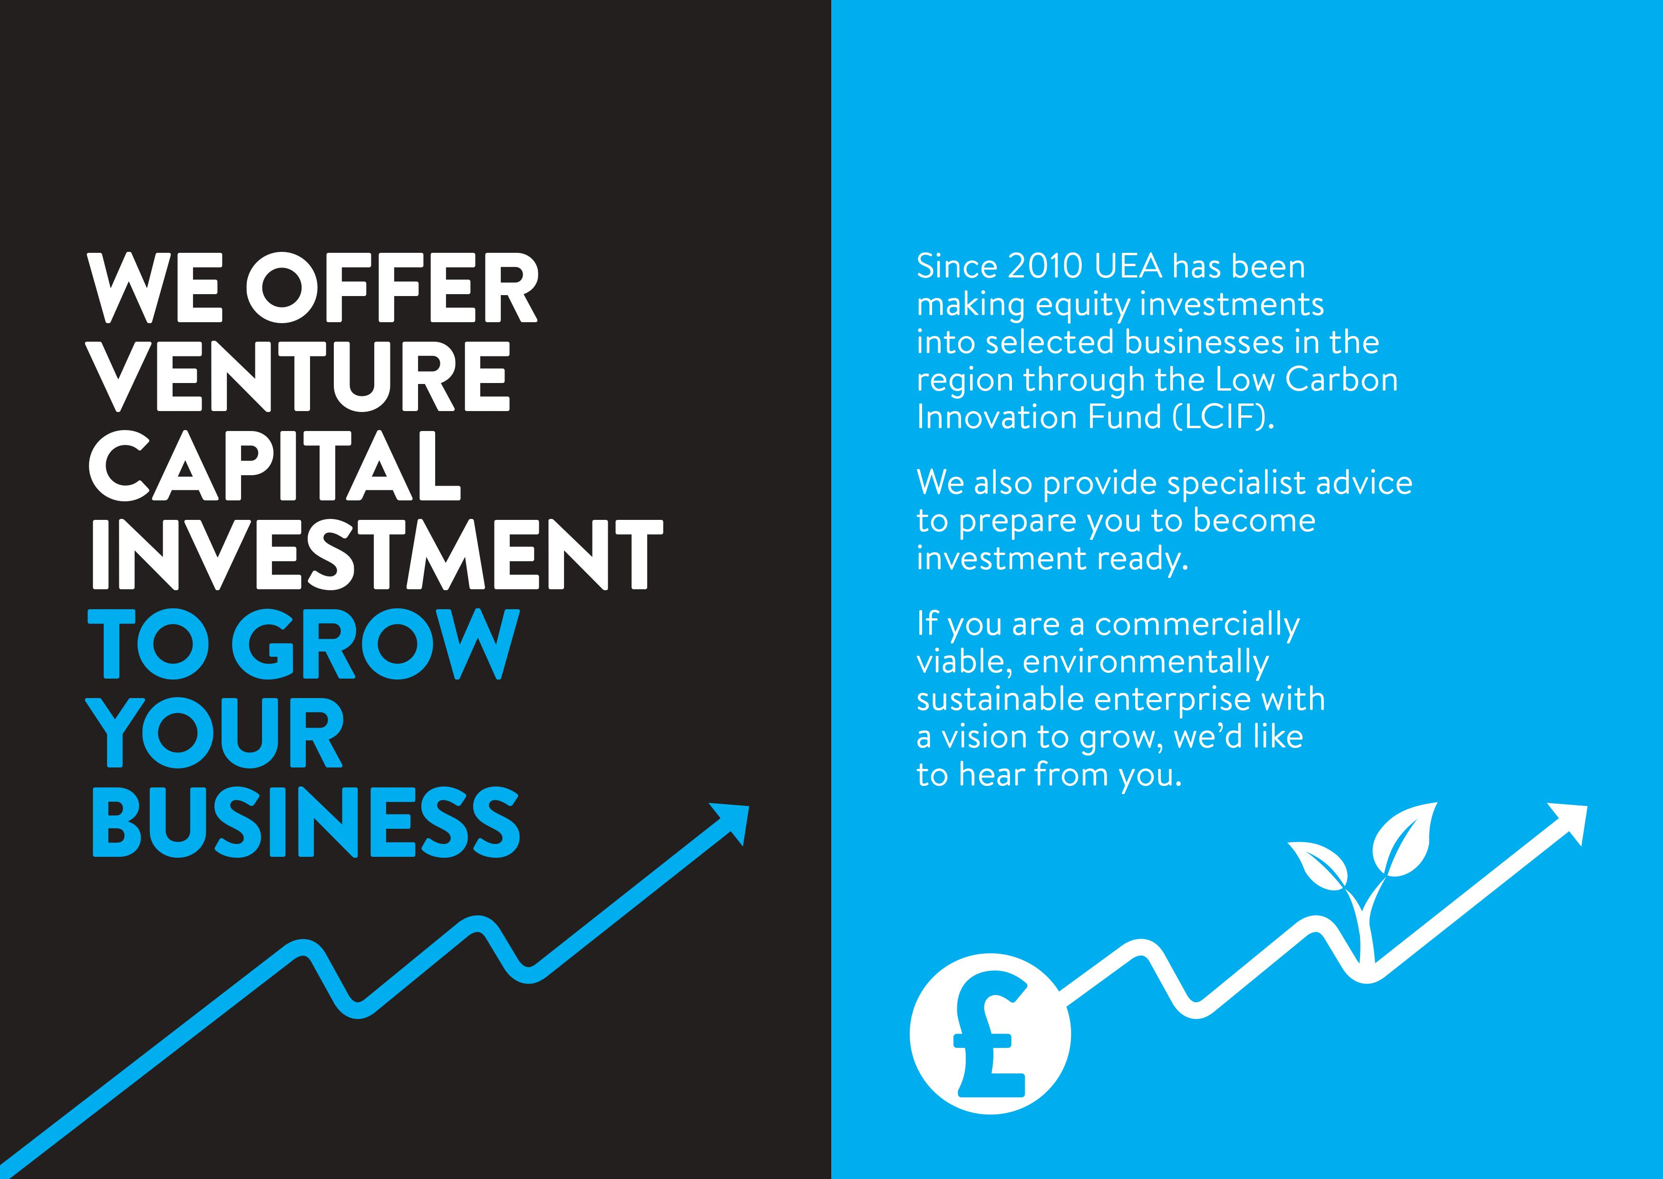
Since 2010 UEA has been making equity investments into selected businesses in the region through the Low Carbon Innovation Fund (LCIF).
We’ve now partnered with Norfolk County Council to support commercially viable, environmentally sustainable enterprises with a vision to grow.
Active across Norfolk, Suffolk, Cambridgeshire, Peterborough and Herts.

Slide 3

The Low Carbon Innovation Fund (LCIF) is a venture capital fund, providing equity finance for businesses that are developing technologies, products and services aimed at reducing greenhouse gas emissions.
LCIF co-invests alongside private sector investors such as founders, angel investors and other funds, providing finance to early and growth stage businesses.
In 2021 alone we invested £1.3M leveraging over £7M from the private sector.

Slide 4
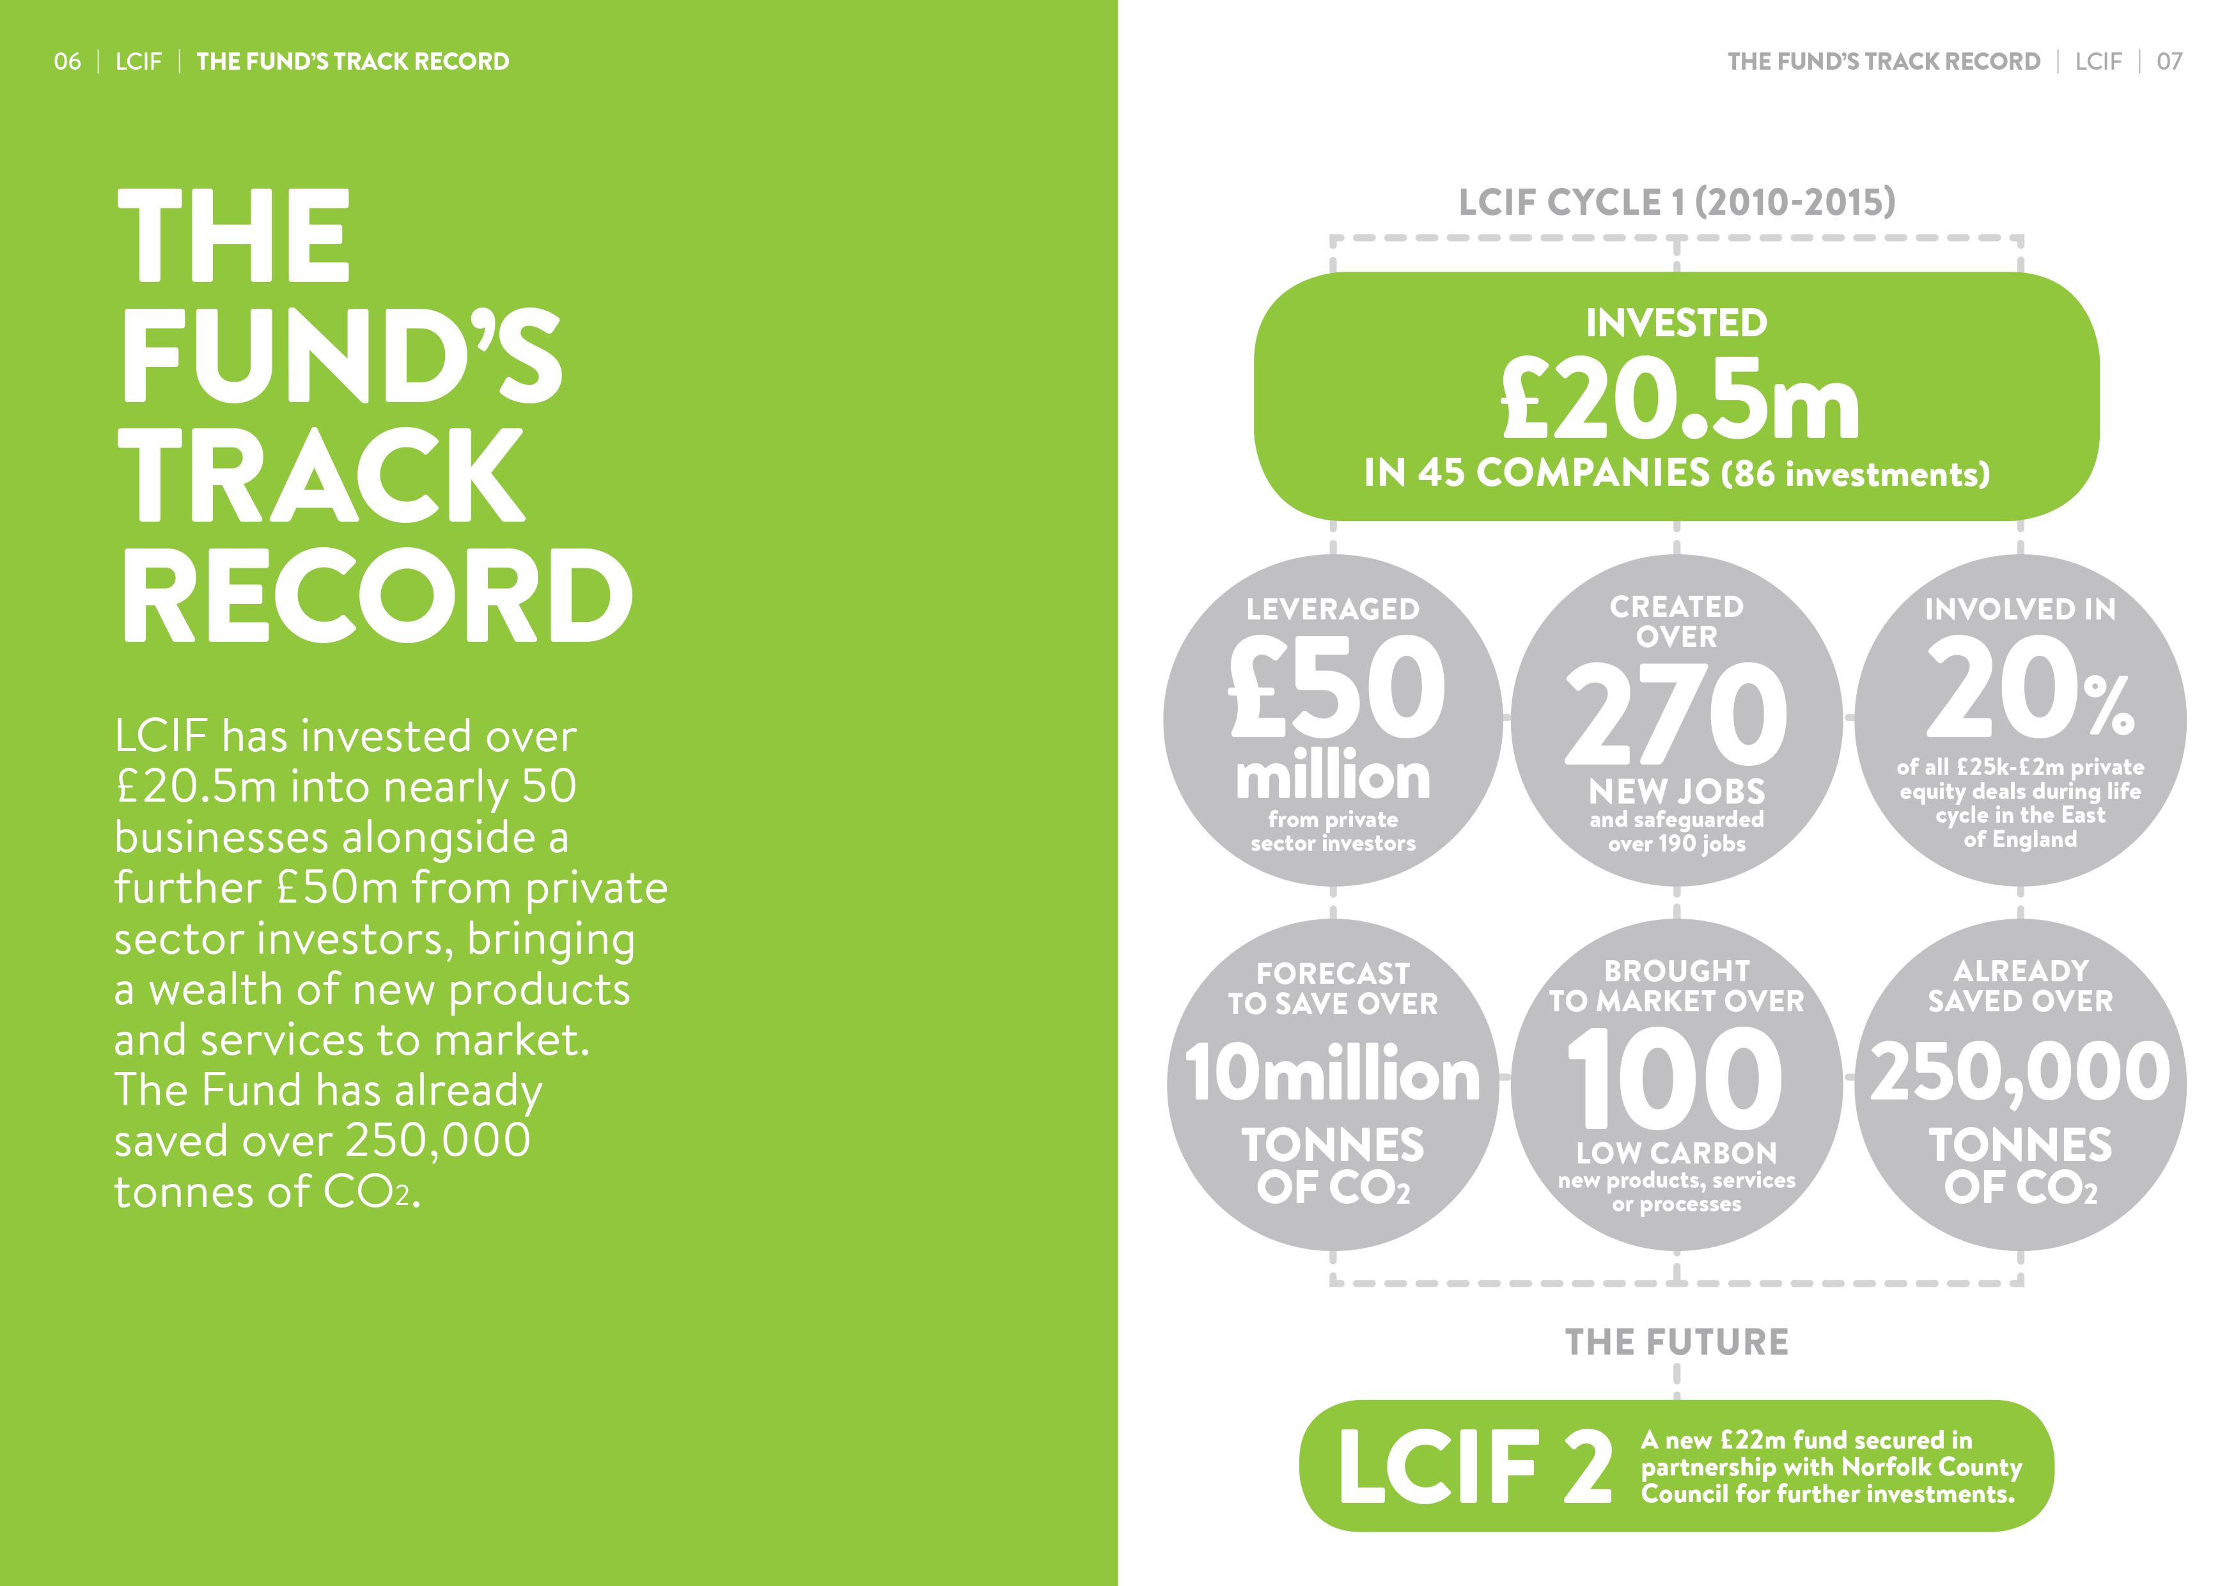
WILL INVEST
more by
2024
£11m

Slide 5
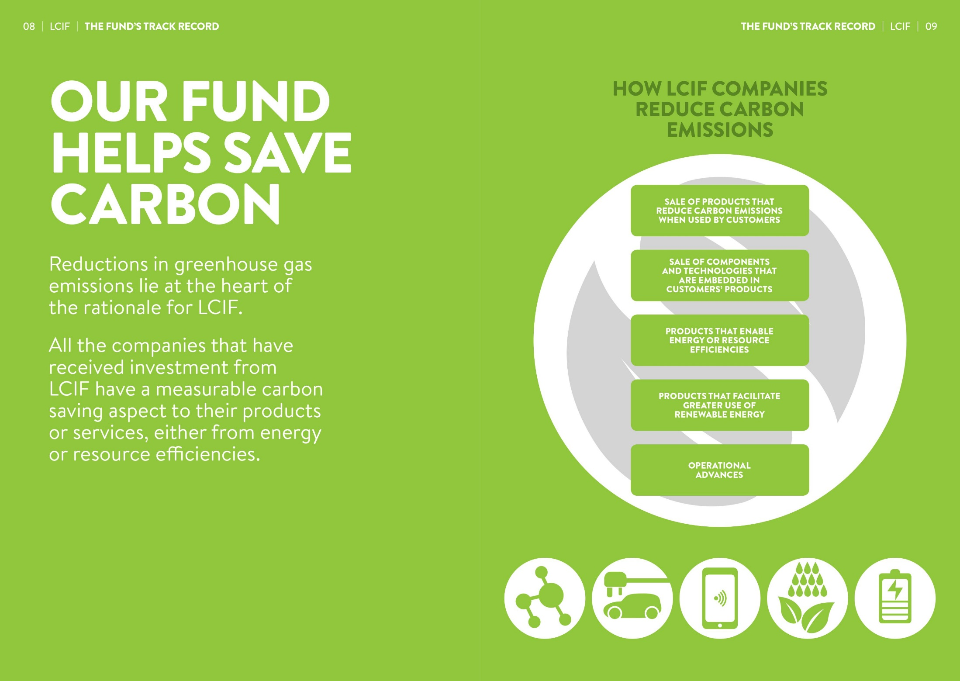















Slide 6
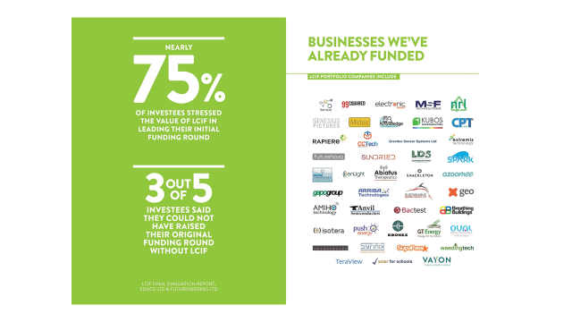

Slide 7
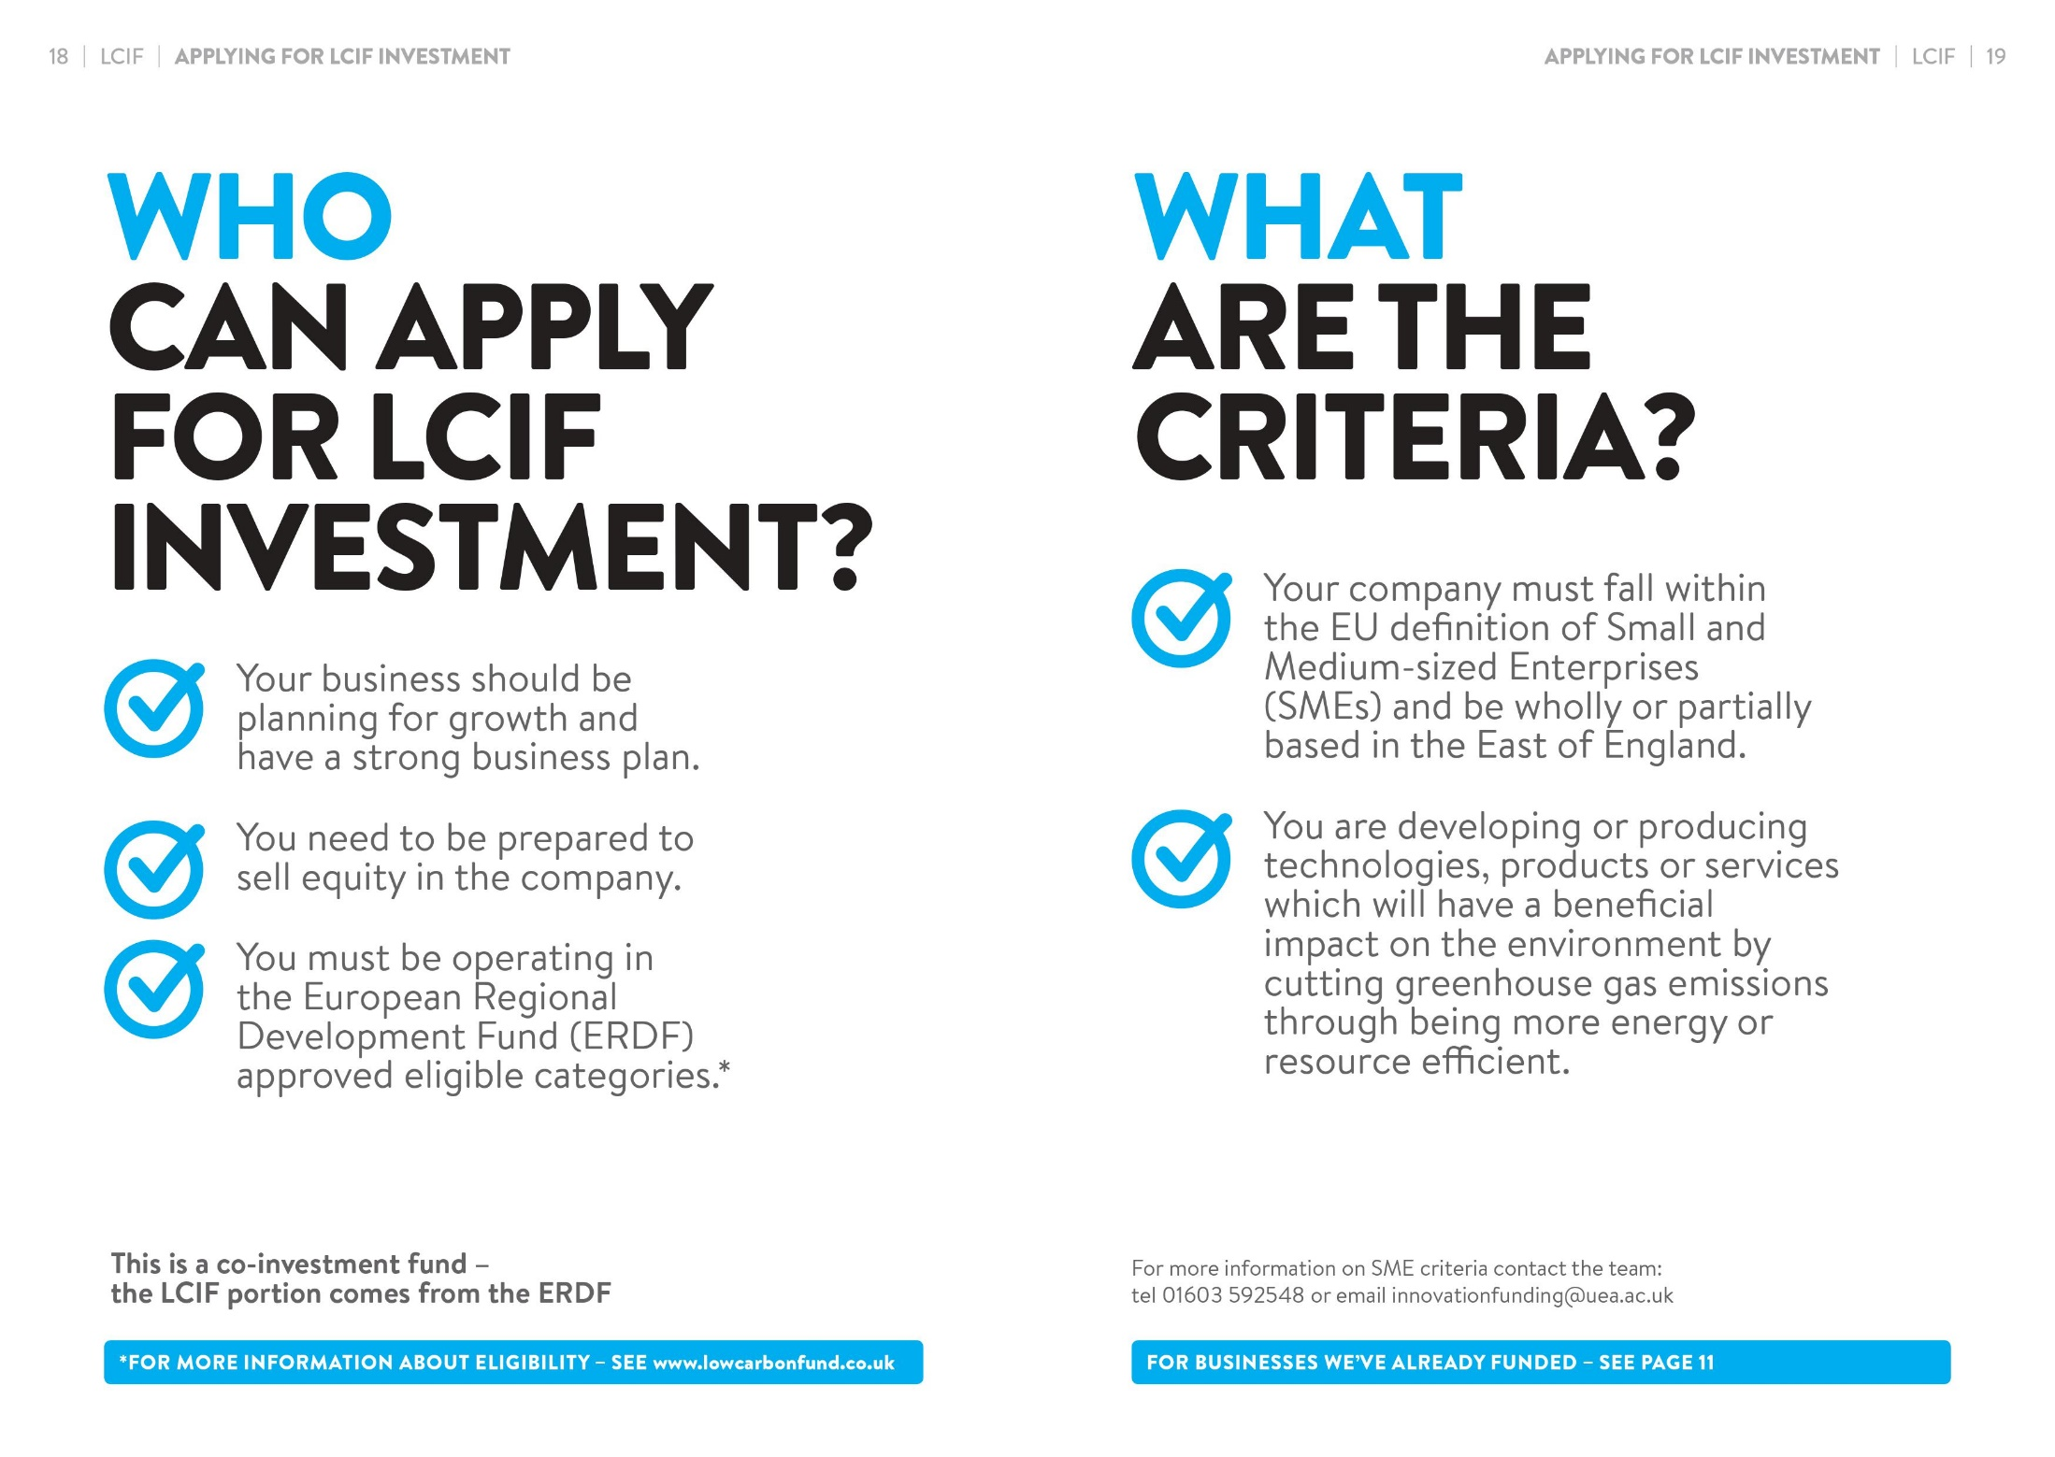
You are developing or producing technologies, products or services which will have a beneficial and measureable impact on the environment by cutting GHG emissions.
Your business should be planning for growth and have a strong business plan
Your company must fall within the EU definition of Small and Medium-sized Enterprises (SMEs).
You need to be prepared to sell equity in the company.
You have a viable business plan.
You must be an SME operating in the European Regional Development Fund (ERDF) approved eligible categories.*
You have a strong and capable team.
You have the ability to raise co-investment from private sector angels or funds.

Slide 8
Key aspects of LCIF2
Early stage businesses are supported through first round of investment
Small public sector investments at early stage bring professionalism and de-risk the opportunity
Provides assurance to private sector investors – leveraging higher proportions of co-investment
LCIF2 provides experienced NED to all portfolio businesses – wide networks of experienced and sector specialists
Patient capital – help to raise in future rounds – follow-on investments
Increases the chances of success of cutting edge technologies in the region
Growth in the Green Economy and a key project in the journey to Net Zero

Slide 9
Applicant criteria
SMEs registered in England with a base in Norfolk, Suffolk, Cambs, Peterborough or Herts
Developing or selling more energy or resource efficient technologies/products/services
Carbon savings that are measurable
Sector agnostic
Sensible valuations that will also attract angel or venture capital
Capable management teams
Actively seeking applications of £25-£50k

Slide 10






CONTACT
www.lcif.vc
Initial enquiries to lcif@uea.ac.uk
or to
s.myhill@uea.ac.uk
Thank you

