Slide 1


BEE ANGLIA
Business Energy Efficiency Anglia
‘The Energy Efficiency Hive for Norfolk & Suffolk’
19th January 2022
Ned Harrison – BEE Anglia Project Manager

Slide 2
Business Energy Efficiency Anglia
Resource efficiency support to eligible SMEs
  SMEs (<250 FTEs)
  Specific exclusions (agriculture; education; etc.)
Grants for specific measures
  New criteria apply; focussing on high impact, innovative results
Carbon Charter accreditations
Telephone advice
www.beeanglia.org / 01473 350 370
Notes:
First want to say a little about BEE Anglia.
ERDF funded project, providing grants and broader environmental support to businesses.
ERDF eligibility rules
What we can support is now restricted to more innovative measures with a clearly demonstrated need for funding.

Slide 3
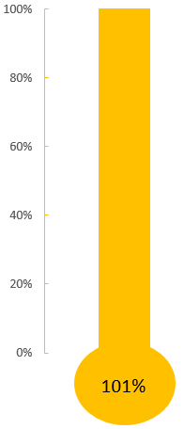
Grants Awarded
£1.6 million since June 2016
260 businesses receiving grants
Average savings of £3,900/ 13 tonnes CO2e per year

Slide 4
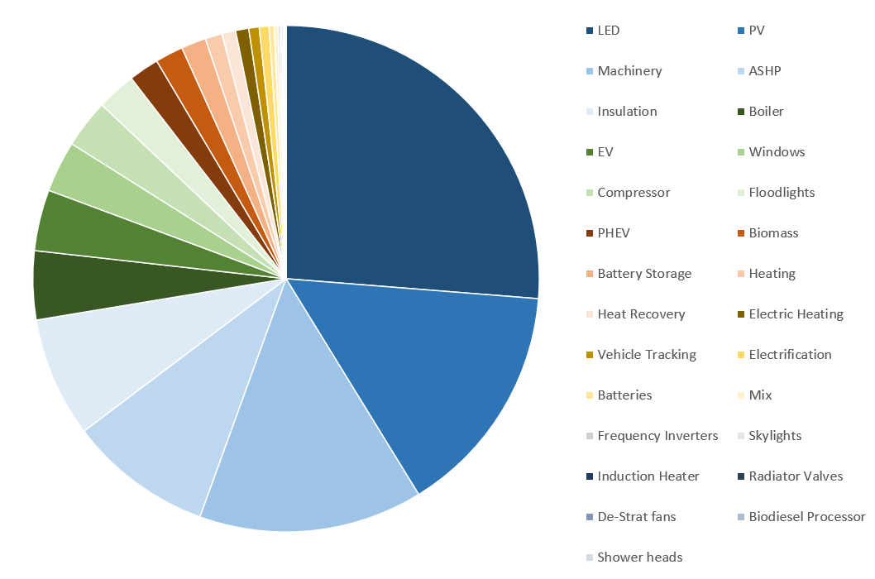
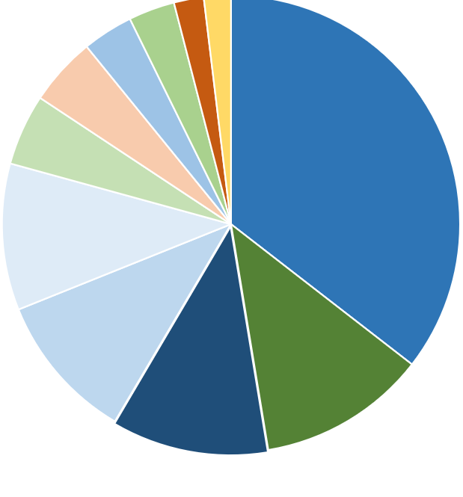
Measures Supported
Since June 2019
Notes:
Shows how the emphasis has changed in the past year.
Now the focus on PV. EVs and Battery Storage also become more popular. And some newer things like heat recovery.

Slide 5
Some of the Grants Awarded
Kiezebrink UK
£17,000 to improve freezer storage facility with heat recovery technology
Estimated savings 33tCO₂e per year,
plus cost savings of £7,450
Essential Care (Organics) Ltd
£3,700 towards roof insulation, LED lighting and automatic lighting controls
Estimated savings 9.7tCO₂e per year,
plus cost savings of over £2,000
The Brook Inn
£2,500 for insulation and double glazing
Estimated saving 9tCO₂e per year,
plus cost savings of £1,700
Clickers Archery
£1,300 for upgrading their current lighting to LED and installing two ASHPs
Estimated savings 2tCO₂e per year,
plus cost savings of £500
Notes:
We have supported a wide range of businesses and technologies.

Slide 6






Carbon Charter
Independent Assessment
Aimed at SMEs
Locally Recognised
Active network of businesses
www.carboncharter.org
Notes:
Bronze, Silver, Gold
Active network – also have events…
The Charter website is freely available and has short guides to a wide range of green topics.
Other accreditations are available.

Slide 7

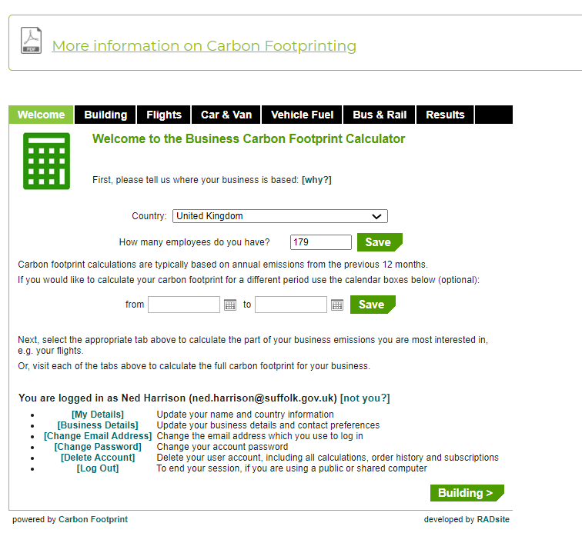
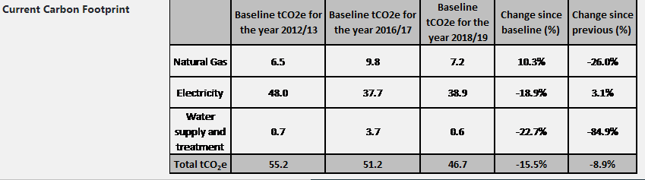
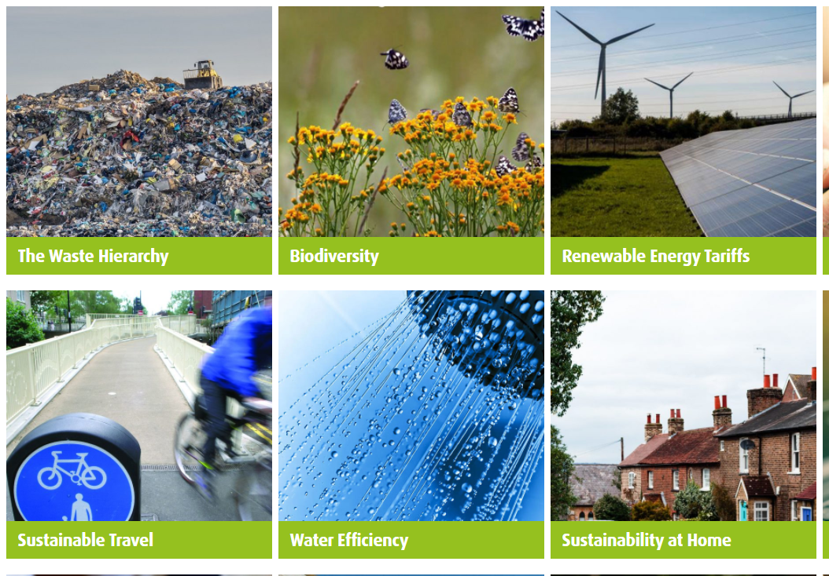
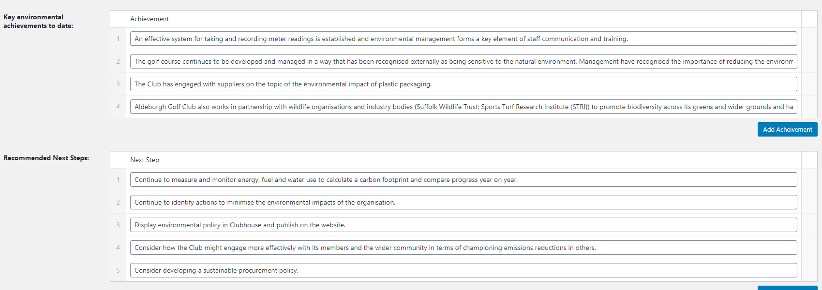


Slide 8

Grants of £1-25,000 for carbon saving projects
Up to 75% of eligible costs
Can include energy efficiency, renewables, supply chain measures, behaviour change, etc.
Projects must be completed by 30th April
0300 333 6536 / info@newangliagrowthhub.co.uk
https://newanglia.co.uk/grant/road-to-net-zero-grants/

Slide 9
Selected Other Funding Pots
West Suffolk Solar for Business
  Free installation of solar panels
  https://www.westsuffolk.gov.uk/protecting-our-environment/solar-for-business.cfm
Government Clean Growth Fund
  Investment in start-up companies developing clean energy solutions
  www.cleangrowthfund.com
Workplace Charging Scheme
  Government grants of up to £350 per socket to encourage uptake of Electric Vehicles in SMEs
  https://www.gov.uk/guidance/workplace-charging-scheme-guidance-for-applicants
New Anglia Growth Hub
  Generalised business support, advice and direction to funding
  https://newanglia.co.uk/
https://carboncharter.org/resources-grants-and-funding/

Slide 10





Stay Informed. Join our mailing list…
https://carboncharter.org/contact-us/
BEEA Project Ned Harrison
Manager: ned.harrison@suffolk.gov.uk
01473 264472

