Slide 1


“The Social Value Act can help us to improve the quality of public services, achieve wider benefits for the community and get the greatest value for every pound of public money” Minister for Civil Society, 2017
Sustainable Procurement
– Bidding With Suffolk County Council
Katrina Browning - Senior Procurement Business Partner
March 2021
Maximising The Suffolk £
Notes:
It is clear that Social Value is transforming the relationship between the public sector and its suppliers - for the better. However, as we rush into a new normal, it is vital that requirements to submit a social value offer do not add an unnecessary burden to the process, especially for SMEs and VCSEs.

Slide 2
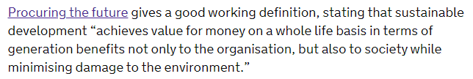
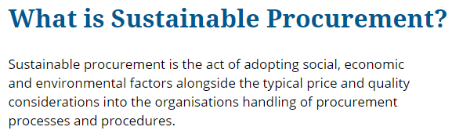


What is Sustainable Procurement ?
Notes:
What is Sustainable Procurement ?
Going back as far as 2011 … The Government created a National Action Plan gives government a clear direction on how to make real progress toward better, more sustainable procurement.
Procuring the future - GOV.UK (www.gov.uk)

Slide 3
Social Value
“An Act to require public authorities to have regard to economic, social and environmental well-being in connection with public services contracts; and for connected purposes”
Public Services (Social Value) Act 2012
Paragrapah 1 (3)
The authority must consider –
how what is proposed to be procured might improve the economic, social and environmental well-being of the relevant area, and
how, in conducting the process of procurement, it might act with a view to securing that improvement.
Notes:
The Act requires public authorities to “have regard” to how social value can be achieved …. in relation to service contracts above the OJEU levels
As of Dec 2020 Above Threshold – Supplies & Services £189,330 or Social and Other Services £663,540

Slide 4
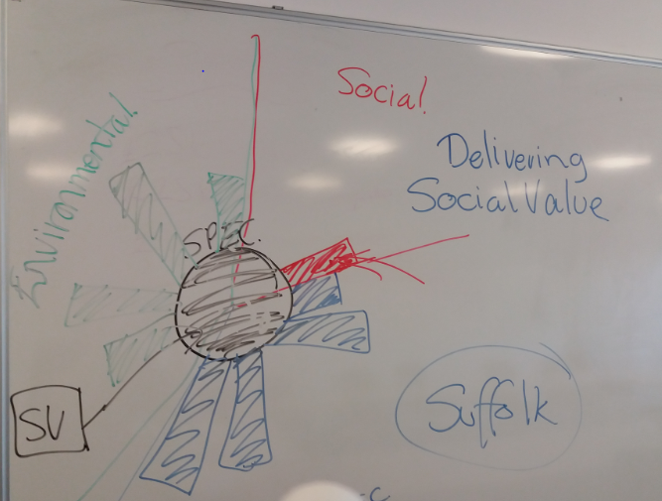
What Is Social Value?
Notes:
So
Commissioners need to consider social value when they design the service and the service model to write it into the service specification.
Procurement need to consider the procurement process used and the evaluation criteria and weighting to use for Social Value
Bidders are asked to maximise the Social Value they can offer in their bid response both in the delivery of the service as specified and the added value social, economic and environmental benefits that they are able to offer / delivery in the “relevant area” e.g. geographical area of the contract.
Procurement should then detail the offer in the final contract. For example in a Social Value Schedule.
Contract Managers need to contract manage the Social Value of the contract as part of the contract management of the contract to ensure that it is delivered and the Social Value in the contract is maximised

Slide 5
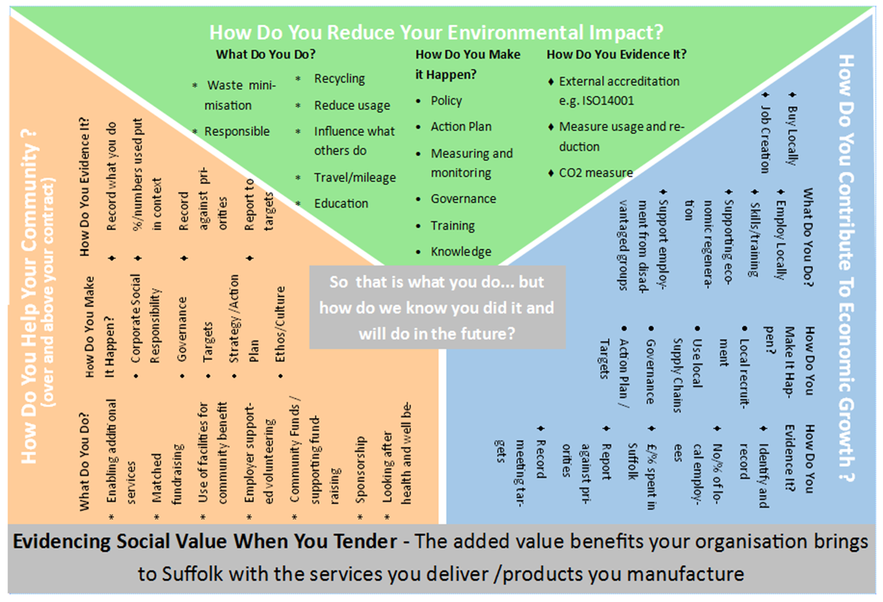
Notes:
Our information sheet developed in partnership with Community Action Suffolk (CAS) our VSC Infrastructure organisation and our community foundation Suffolk Community Foundation.
Single sheet intended as a tool to help providers to both understand what Social Value is and also to help identify how they can add Social Value and how to evidence it.
Used in our tender documents, at market engagement events and as a tool internally to help raise awareness and understanding. As an empty sheet its also a useful tool to share with bidders to help them map their own offer.

Slide 6
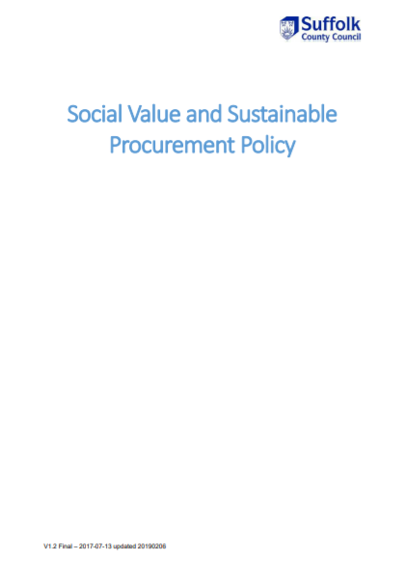
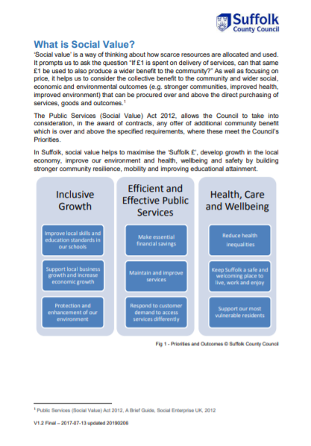
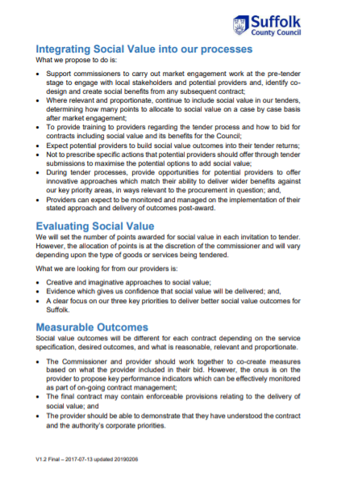
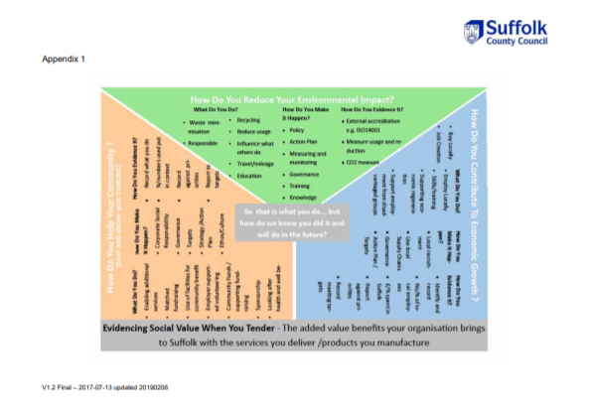
Social Value and Sustainable Procurement Policy (2017)
Scrutiny recommendation to create a “simple, but robust, social value policy”
Developed in consultation with Suffolk Chamber and VCS
Encompasses all contracts not just above OJEU service contracts
Clearly links to our corporate priorities
Notes:
Following the Lord Young review of the Social Value Act In 2016 our Scrutiny Committee looked at procurement in the Council and one of the recommendation was to introduce a Social Value Policy.
We developed our Social Value and Sustainable Procurement Policy working with stakeholders such as our Local Chamber of Commerce, our contractors and our local VCS infrastructure organisation Community Action Suffolk (CAS). We’ve kept our policy to a couple of pages to encourage colleagues to read and understand it.
We ve kept our policy short and to the point……. the policy requires staff to consider social value for all tenders where relevant and proportionate, determining how many points (weighting) to allocate to social value on a case by case basis
Our policy - https://www.suffolk.gov.uk/assets/Jobs-careers-and-business/tenders-and-supplying-us/Social-Value-and-Sustainable-Procurement-Policy.pdf
Community Action Suffolk had originally proposed developing a local toolkit to support providers to identify and measure Social Value and asked us for our support. However rather than develop a Suffolk toolkit when there is so much work nationally and the TOMs were being developed, we worked with Community Action Suffolk and Suffolk Community Foundation and developed a single page information sheet

Slide 7
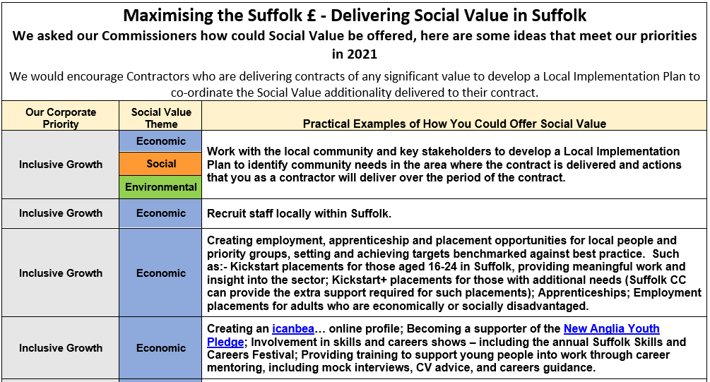
Examples from our Annual Social Value Ask
Notes:
To help embed understanding both with our commercial staff (commissioners, contract managers and procurement colleagues), our supply chain and bidders we’ve articulated our social value ask into an annual request. To offer ideas and guidance to bidders.

Slide 8
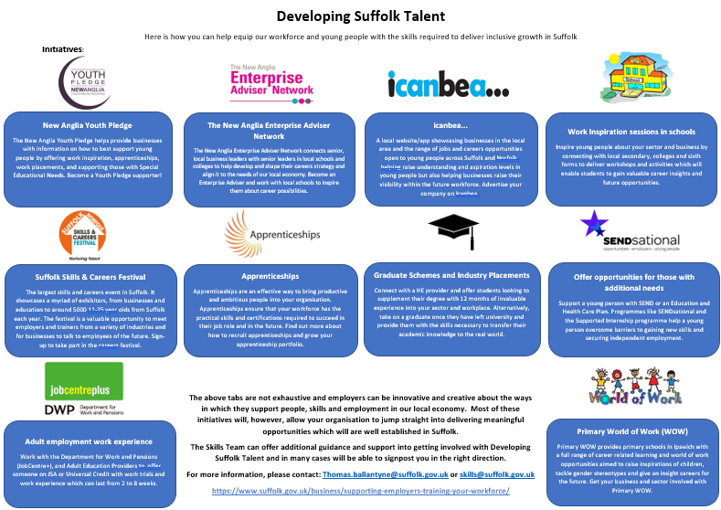
Notes:
To add clarity to our economic ask we worked with our Skills team to develop a one page information sheet to include in our tenders to encourage our supply chain to engage with our Skills agenda to support Inclusive Growth in Suffolk.

Slide 9
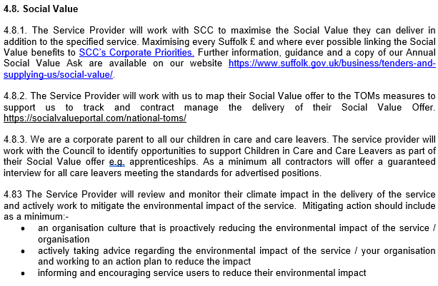
Suffolk Example: Social Value in a Specification
Evaluation criteria must relate to the contract e.g. requirements that appear in your Specification
Example from CYP Service Specification template
Notes:
Be clear to bidders what you what them to deliver…

Slide 10
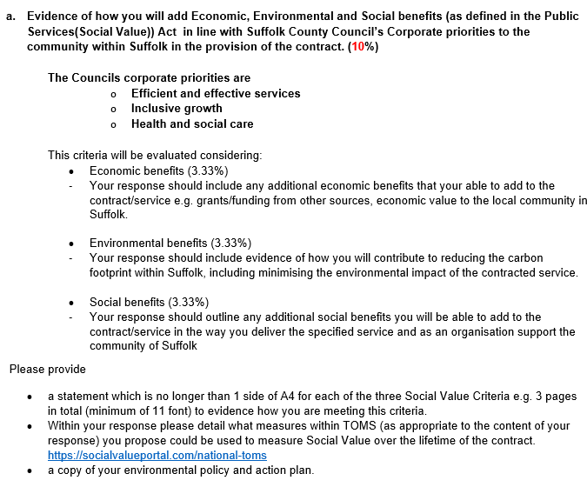
Suffolk Example: Social Value Evaluation Criteria
Evaluation criteria are specific to the tender
CCS Growth Balanced Scorecard
Example is available is needed
Now includes reference to TOMS
Notes:
In our high spend works and capital related contracts (construction related) we use the CCS (Crown Commercial Services) Balanced Score Card
https://www.gov.uk/government/news/launch-of-the-procuring-for-growth-balanced-scorecard
This is a template example of criteria used, a similar criteria has been used in almost all our CYP service contracts since the Act. However our buyers don’t have to use this template, they will write in the criteria appropriate to the market and what’s being purchased.
….. Asks for specific responses back regarding social value … maximising the opportunity for the bidders to offer what they can and what fits with their business.
Note – recent tenders have started to refer to the TOMs measures asking bidders to identify which TOMs measures are most appropriate to measure their SV offer…

Slide 11
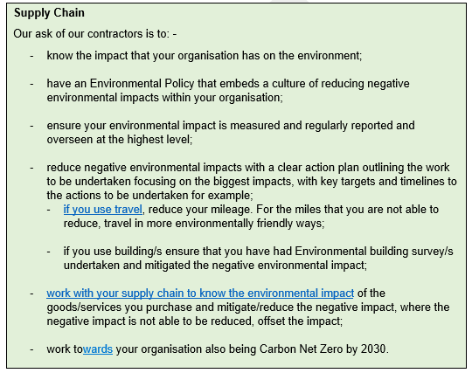
Our Ask Of Our Supply Chain
Our Climate Change Commercial Ask is due to be published later this month
Notes:
Our Climate Change Commercial Ask which is due to be published this month outlines our ask of our supply chain and of our staff in commercial roles.
It will be available on our Website along with further information and guidance. Details will of course be shared via the Carbon Charter.

Slide 12
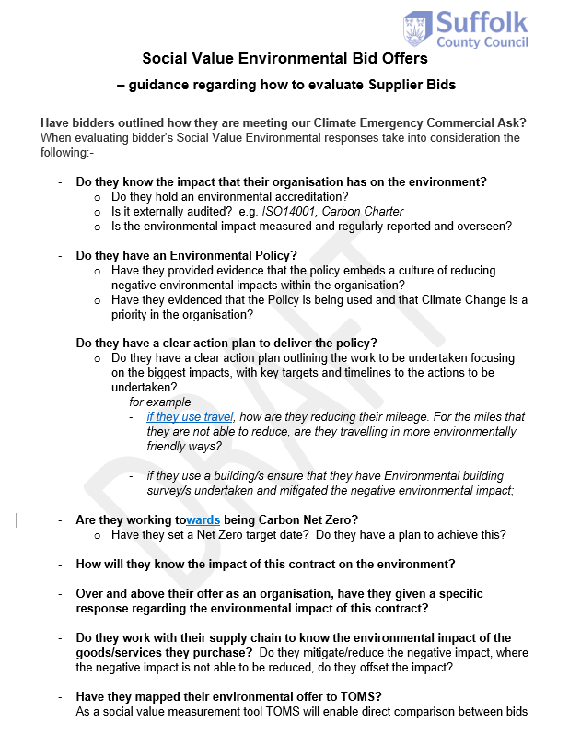
Social Value Environmental Bid Offers
– guidance regarding how to evaluate Supplier Bids
Do they know the impact that their organisation has on the environment?
Do they have an Environmental Policy?
Do they have a clear action plan to deliver the policy?
Are they working towards being Carbon Net Zero?
How will they know the impact of this contract on the environment?
Over and above their offer as an organisation, have they given a specific response regarding the environmental impact of this contract?
Do they work with their supply chain to know the environmental impact of the goods/services they purchase?
Have they mapped their environmental offer to TOMS?
Notes:
An example of the guidance to company our Climate Change Commercial Ask ……
Do they know the impact that their organisation has on the environment?
Do they hold an environmental accreditation?
Is it externally audited? e.g. ISO14001, Carbon Charter
Is the environmental impact measured and regularly reported and overseen?
Do they have an Environmental Policy?
Have they provided evidence that the policy embeds a culture of reducing negative environmental impacts within the organisation?
Have they evidenced that the Policy is being used and that Climate Change is a priority in the organisation?
Do they have a clear action plan to deliver the policy?
Do they have a clear action plan outlining the work to be undertaken focusing on the biggest impacts, with key targets and timelines to the actions to be undertaken?
for example
if they use travel, how are they reducing their mileage. For the miles that they are not able to reduce, are they travelling in more environmentally friendly ways?
if they use a building/s ensure that they have Environmental building survey/s undertaken and mitigated the negative environmental impact;
Are they working towards being Carbon Net Zero?
Have they set a Net Zero target date? Do they have a plan to achieve this?
How will they know the impact of this contract on the environment?
Over and above their offer as an organisation, have they given a specific response regarding the environmental impact of this contract?
Do they work with their supply chain to know the environmental impact of the goods/services they purchase? Do they mitigate/reduce the negative impact, where the negative impact is not able to be reduced, do they offset the impact?
Have they mapped their environmental offer to TOMS?
As a social value measurement tool TOMS will enable direct comparison between bids

Slide 13
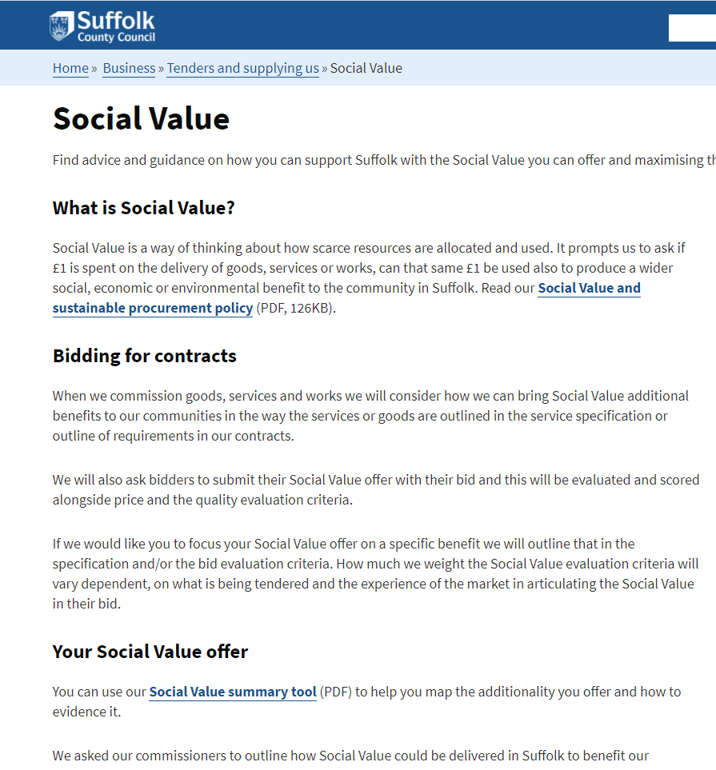
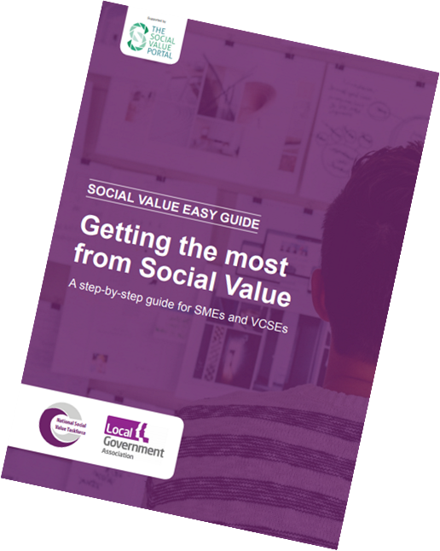
Social Value – Further Information
Social Value | Suffolk County Council
Social-Value-Easy-Guide_For-SME-VCSE_July-2020-1.pdf (socialvalueportal.com)

Slide 14

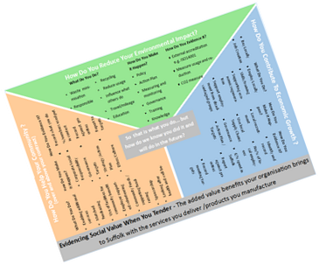
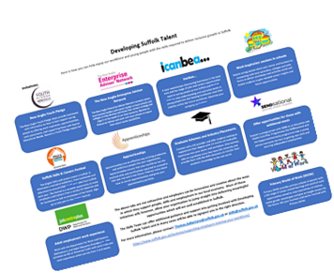
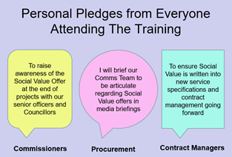
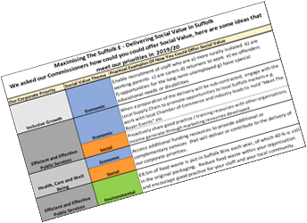

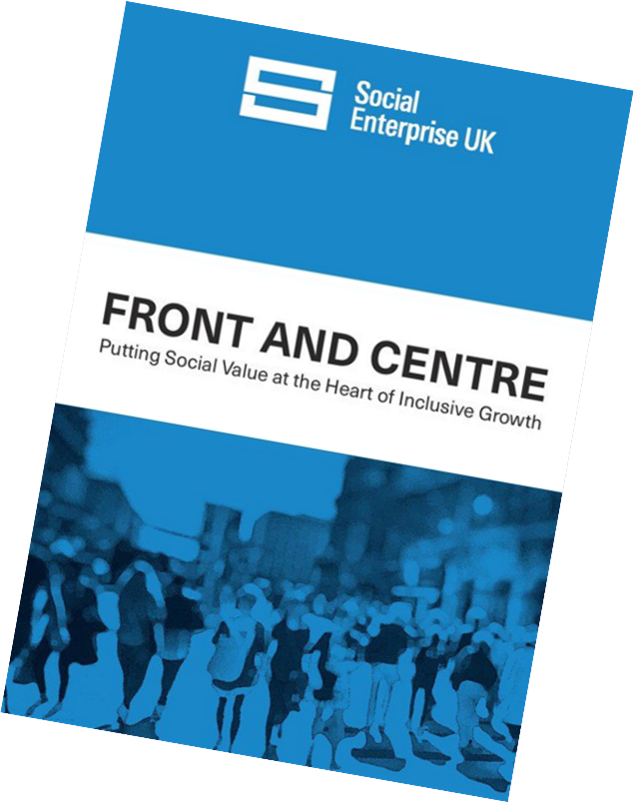
  Katrina Browning
  Senior Procurement Business Partner
  katrina.browning@suffolk.gov.uk
https://www.suffolk.gov.uk/business/tenders-and-supplying-us/social-value/

