Slide 1



Climate Emergency Declaration
An update on the Council’s response
David Walton, Programme Manager SCCP
Matt Hullis, Head of Environment Strategy
Notes:
1

Slide 2
Tackling the Climate Emergency
Objectives:
Net zero carbon emissions for SCC by 2030
Deliver reputational and financial benefits to SCC by successfully managing the risks and opportunities climate change presents.
Work with other organisations and the communities to aim for a carbon neutral Suffolk at the earliest opportunity.
Principles:
Consider all future policy and investment decisions in the context of the Climate Emergency.
Reinforce the strong Greenest County ambition.
Identify and deliver a SCC investment program to effectively manage emissions and the potential of carbon storage.

Slide 3
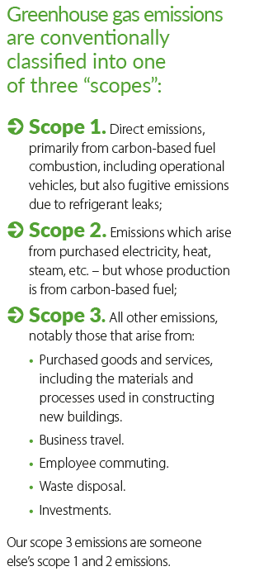
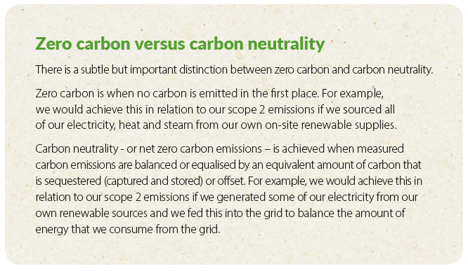
County Council emission reduction – measuring and targets
Action to reduce is what counts

Slide 4
Cabinet Approved Actions – Internal Emission Reduction
Cabinet paper link: https://committeeminutes.suffolk.gov.uk/DocSetPage.aspx?MeetingTitle=(14-07-2020),%20The%20Cabinet
Officers to develop detailed, costed, policies, projects and working practices for approval, which will contribute to the Council achieving the ambition of net zero emissions for its own operations by 2030. Overseen by Climate Change and Energy Governance Panel
Buildings and utilities - greener electricity; move away from gas and oil for heating; energy efficiency projects; new builds designed to be net-zero
Transport – switch to EV for pool fleet and small service vehicles over 3 years; pilot switch for larger vehicles as option emerge.
Notes:
Wording varies

Slide 5
Cabinet Approved Actions (cont.)
Farm Estate – maximise energy generation (solar PV initially); investigate potential to store carbon on the estate; encourage low carbon tenants.
Procurement - training for procurement advisors and suppliers; updated guidance and contractual terms to include carbon reporting; develop a recording and monitoring process to manage embedded emissions
Corporate Strategy / Policy - All future policy development and committee decisions to consider and evaluate the impact on net zero emissions target to help inform decision making; annual publication of emissions and progress to net zero; wholly owned companies to adopt a net-zero approach.
Working with staff/Cllrs – training to raise awareness and change behaviour; embed positive behaviour learnt during lockdown to reduce future travel emissions
Notes:
Wording varies

Slide 6
Suffolk Climate Emergency Plan development
a. Undertake analysis of existing data to provide a clear, evidence- based baseline.
b. Understand the extent to which we can reduce emissions identified by the analysis.
c. Present opportunities for action across key sectors.
d. Engage widely.
e. Co-design and launch a delivery plan.
f. Initiate delivery of the plan!
Notes:
a) – c): Ricardo Energy & Environment – completing

Slide 7
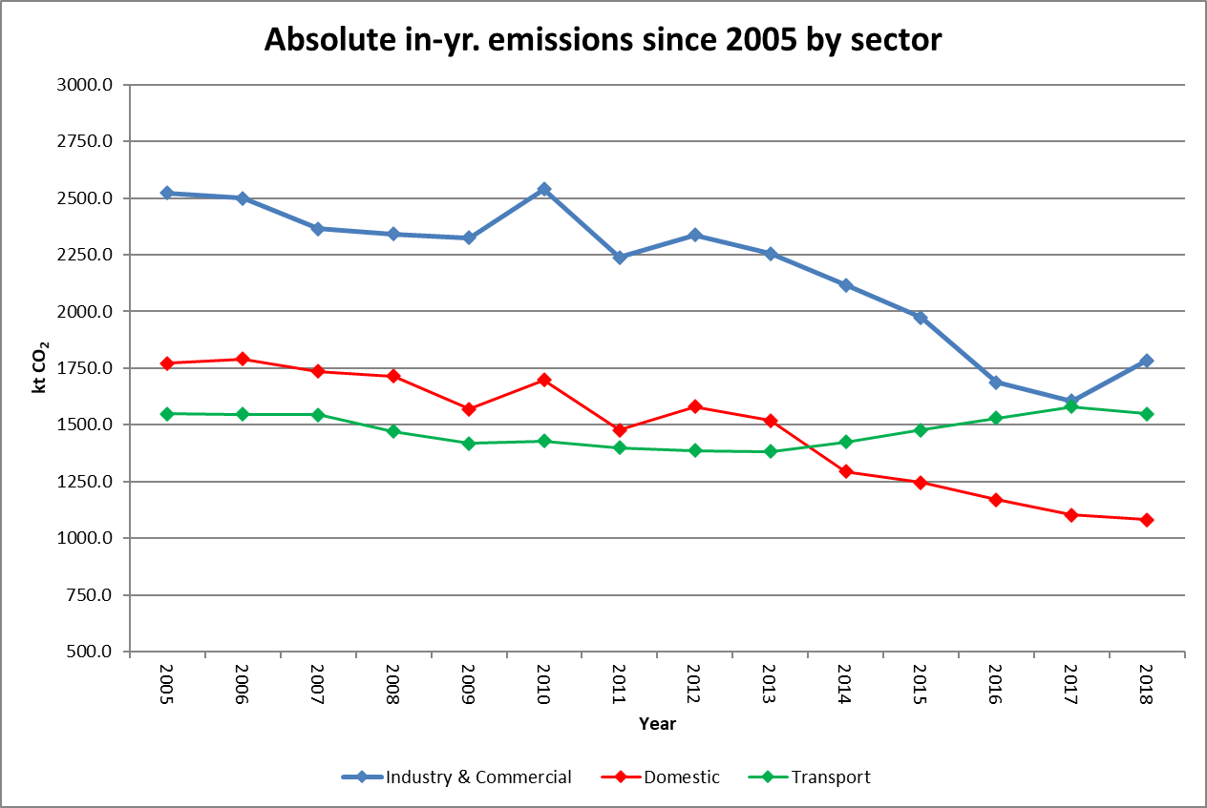
Suffolk’s emissions
Notes:
Source: BEIS

Slide 8
Getting to carbon neutral: Priorities
Improving the thermal efficiency of the building stock and decarbonising the supply of heat.
Encouraging greater take-up of public transport and active travel (walking and cycling) and a massive roll-out of zero emissions vehicles.
In addition, Suffolk should consider:
Increasing uptake of local distributed renewables, as a way of reducing reliance on national-level grid decarbonisation.
Working with industry on decarbonisation options.
Notes:
Wording varies

Slide 9
Key messages: Buildings
Many more homes need to be more thermally efficient and all homes will need to switch to some form of low carbon heating by 2030.
As other low carbon heating options, such as district heating, have relatively less potential in Suffolk than in other parts of the country, and other options, such as hydrogen, are unlikely to be scaled up in time, huge numbers of heat pumps will be needed: around 330,000 by 2030.
There should be a big push in initial years on building energy efficiency retrofit, to reduce emissions in the short term and to prepare buildings for heat pumps.
Heat pump installations should be encouraged now where feasible, e.g. Councils’ own buildings, new build developments, able-to-pay householders.
Meanwhile, an upskilling should be encouraged through training courses to ensure there are enough heat pump installers to meet the increasing demand.
A larger-scale scheme for incentivising greater heat pump uptake will be needed to reach the numbers required in later years.
Notes:
Wording varies

Slide 10
Key messages: Transport
Most vehicles on the road in Suffolk will need to be zero emission (mostly fully electric) by 2030.
Encourage modal shift to public transport and active travel (walking and cycling). However, rurality presents challenges.
Modelling a 25% reduction in car miles and a 15% reduction in freight miles reduces vehicle numbers to 390,000 by 2030 – all would need to be zero emission.
Greater numbers of zero emission vehicle uptake will be needed in later years and this would need scrappage incentives to take vehicles off the road that have not yet reached end of life.
There will need to be around 300,000 private charging points for cars and vans, and around 3,300 public charging points (73% standard, 23%, 4% rapid). This would add about 1,000 GWh of electricity demand by 2030: about 30% of existing electricity consumption.
Notes:
Wording varies

Slide 11
Key messages: Power
For Suffolk to be carbon neutral by 2030, the supply of electricity needs to fully decarbonise by then.
This means decarbonising the generation of electricity that feeds into the grid and/or creating more renewables within Suffolk for local use (distributed renewables).
Some reliance on grid decarbonisation by 2030 is unavoidable.
Increasing levels of distributed generation will help limit Suffolk’s reliance on grid decarbonisation and manage the risk of not meeting its carbon neutrality target. This can be less cost effective than large scale renewables, however.
Notes:
Wording varies

Slide 12
Phase 2: Engagement Workshops
Sustainable buildings (retrofit and new build) covering efficiency and renewable power
Energy and planning
Large industry and commercial energy users
Small industrial and commercial energy users
Transport and air quality
Community action and initiatives
Notes:
Wording varies

Slide 13
Engagement Workshops
Objectives:
  Create a collaborative community of engaged stakeholders
  Generate priority actions with indicative targets, to be taken forward into Plan
Structure:
  Present the updated evidence on carbon emissions and air quality
  Review the proposed measures and actions
  Explore delivery barriers and how these can be overcome
  Identify responsibilities for Councils and partners
Notes:
Wording varies

Slide 14
Recommendations and Plan
Actions:
  Expected impact
  Indicative costs
  How these can be delivered
  Who will be involved
Notes:
Wording varies

